Slide 1
FSMA at (almost) 9
New Learning Curve Ahead
WAFFP 2018
Chelan WA
CMBreen LLC
Charles.breen@outlook.com

Slide 2
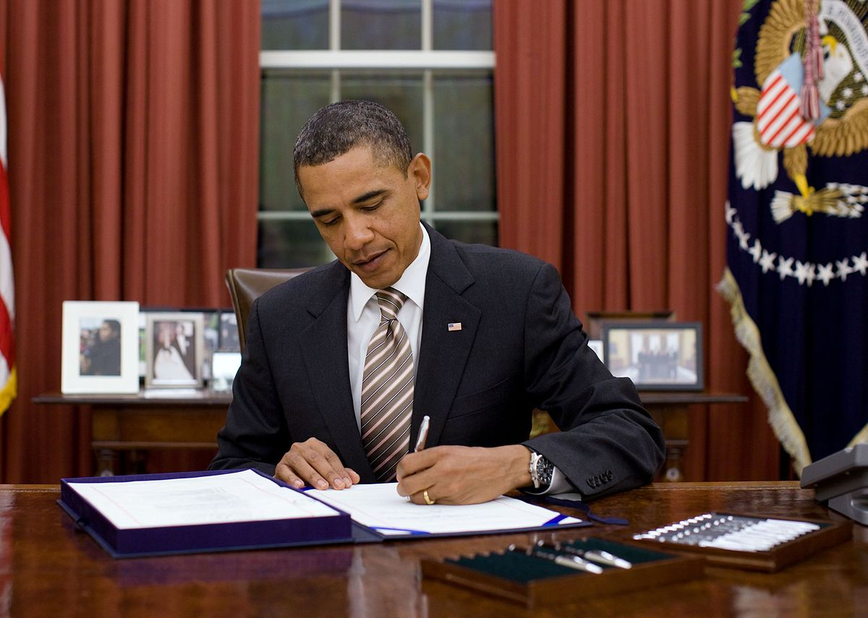
Jan 4, 2011 FSMA signed into law

Slide 3
PCHF Enforcement Timeline Almost Complete
Every food facility is already under their applicable Part 117 PCHF regulations except:
Exempted firms, e.g., alcoholic beverages
Exceptions for farms owned by small and very small businesses*
* FR notice Sept. 17 postponing revocation of Part 110 to maintain status quo

Slide 4
PCHF Enforcement Has Begun
2018 Warning Letter language has shifted, depending on size of firm, from citing Part 110 to Part 117
Part 110 citation in March
Mar 23 “You failed to take effective measures to exclude pests from your processing areas and to protect against contamination of food on the premises by pests, as required by 21 CFR 110.35(c). Specifically, . . . evidence of rodent activity near food storage and preparation areas . . ..”

Slide 5
PCHF Enforcement Has Begun
Part 117 citation in June:
June 29 “That inspection revealed serious violations of subpart B of the Current Good Manufacturing Practice (CGMP), Hazard Analysis, and Risk-Based Preventive Controls for Human Food regulation, . . .(21 CFR 117) (CGMP & PC Rule). The violations include significant evidence of rodent activity and insanitary conditions throughout your facility.”
Warning Letters issued for typical CGMP failures until:

Slide 6
PCHF Enforcement Has Begun
July 26, WL to RTE
breakfast cereal
manufacturer
“Your hazard analysis did
not identify a known or
reasonably foreseeable
hazard . . . to determine
whether there are any
hazards requiring a
preventive control as required by 21 CFR 117.130(a)(1).”

Slide 7
PCHF Enforcement Has Begun
“Between September 29, 2016 and May 16, 2018, you . . . found Salmonella throughout your facility, including in cereal production rooms . . . you had 81 positive Salmonella environmental samples and 32 positive Salmonella vector samples”
113 Salmonella positive swabs?

Slide 8
PCHF Enforcement Has Begun
Positive results did not trigger a “reanalysis of your food safety plan as required by 21 CFR § 117.170(b)(4) and the identification of contamination of RTE cereal with environmental pathogens as a hazard requiring a preventive control (i.e., sanitation preventive control).”
113 Salmonella positive swabs!

Slide 9
PCHF Enforcement Has Begun
Nor did firm “implement [their] written corrective action procedures that must be taken if preventive controls are not properly implemented to comply with 21 CFR 117.150(a)(1) and (d).”
IMO, firm had a SOP that looks good for customers but actually hard to do .

Slide 10
PCHF Enforcement Has Begun
“However, you did not conduct and document a root cause analysis for the persistent findings of Salmonella in your facility during the time period of September 29, 2016 to May 16, 2018.”
IMO, another procedure for customer consumption more than actual implementation.
Other Part 117 preventive control failures cited, but not inadequate PCQI.

Slide 11
PCHF Enforcement Has Begun
Regulatory History Learning curve begun
What FDA will cite for Part 117 in Warning Letters – no longer a completely blank slate.
More WL’s will answer “What is important to FDA?”
And, “Just how bone-headed were those guys?”

Slide 12
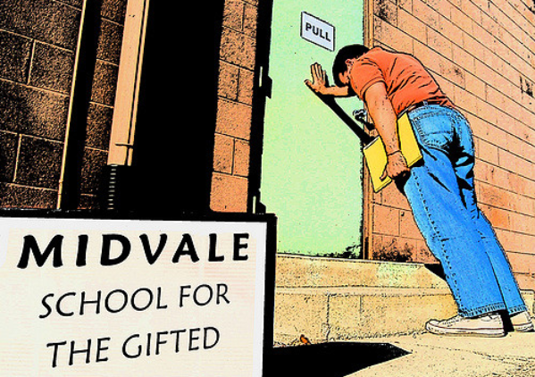
School for Bonehead Management

Slide 13
PCHF Enforcement Has Begun
Regulatory history will mark boundaries of what works for safety and FDA acceptance, and what is not good enough.
Meanwhile, some things are clear.

Slide 14
PCHF Enforcement Has Begun
Management
commitment is vital.
The chicken supports breakfast, the pig is committed.

Slide 15
PCHF Enforcement Has Begun
Don’t over complicate the Food Safety Plan.
Firm receiving preventive controls WL did not follow its own corrective action procedure.

Slide 16
PCHF Enforcement Has Begun
Don’t over complicate the Food Safety Plan.
Manufacturing a non-highly processed cooking oil from a tree nut.
Draft Food Safety Plan (FSP) identified 14 preventive controls.
Most were cleaning and sanitation controls.
Revised FSP now with one preventive control and strong GMP program.

Slide 17
PCHF Enforcement Has Begun
Supply chain urgency continues to grow.
Firm receiving 117 preventive controls WL is a breakfast cereal contract manufacturer.
Kellogg’s recalled lots of RTE breakfast cereal this spring.

Slide 18
PCHF Enforcement Has Begun
Sanitation and pest control are always important.
Language barriers to training must be overcome to have qualified employees.
Don’t neglect FSP reassessment. When is your plan due for review?

Slide 19
PCHF Enforcement Has Begun
FDA is learning, too
Significant resources going into training Investigators and State regulators.
Early mistakes on what is a CGMP violation have dropped off.
Whole Genome Sequencing is getting better and better

Slide 20
PCHF Enforcement Has Begun
The learning curve on what moves FDA to act will develop over time.
Glitches happen (sandwich firm)
Always better to learn from someone else’s failure – as long as there is commitment to the lessons.

Slide 21
PCHF Enforcement Has Begun
QUESTIONS?

