Slide 1
More than Overhead
Combining FSQA and lean objectives to add value to your company
Austin Bouck
EartH₂O - Furfarmandfork.com
Notes:
Good morning, I’m excited to be your 0800 presenter, it’s the time of day where expectations are simple, so let’s see if I can manage them.
For all the researchers here, everything went exactly to plan in the lab yesterday and I didn’t break anything.
For the regulators, there have been no public calls, I have no unexpected plan reviews, and you’ll be happy to hear that Campbells resort had no violations during the last inspection.
For the managers, don’t worry, nothing horrible happened while you were off shift and I’m going to let you finish your coffee before I need anything from you.
My name is Austin Bouck and I’m the QA manager at EartH2o, a small bottled water and beverage company in central Oregon. We’ve got about 100 employees company-wide and about 30 at our manufacturing facility in Culver. I’ve also written about food safety for a long time on my website furfarmandfork.com.
Today I’m here to talk a little about lean. I’m not a six sigma black belt or otherwise formally trained, however I’ve been fortunate enough to be mentored by others in lean philosophy and encouraged to use those principals in all areas of the business, not just production.

Slide 2
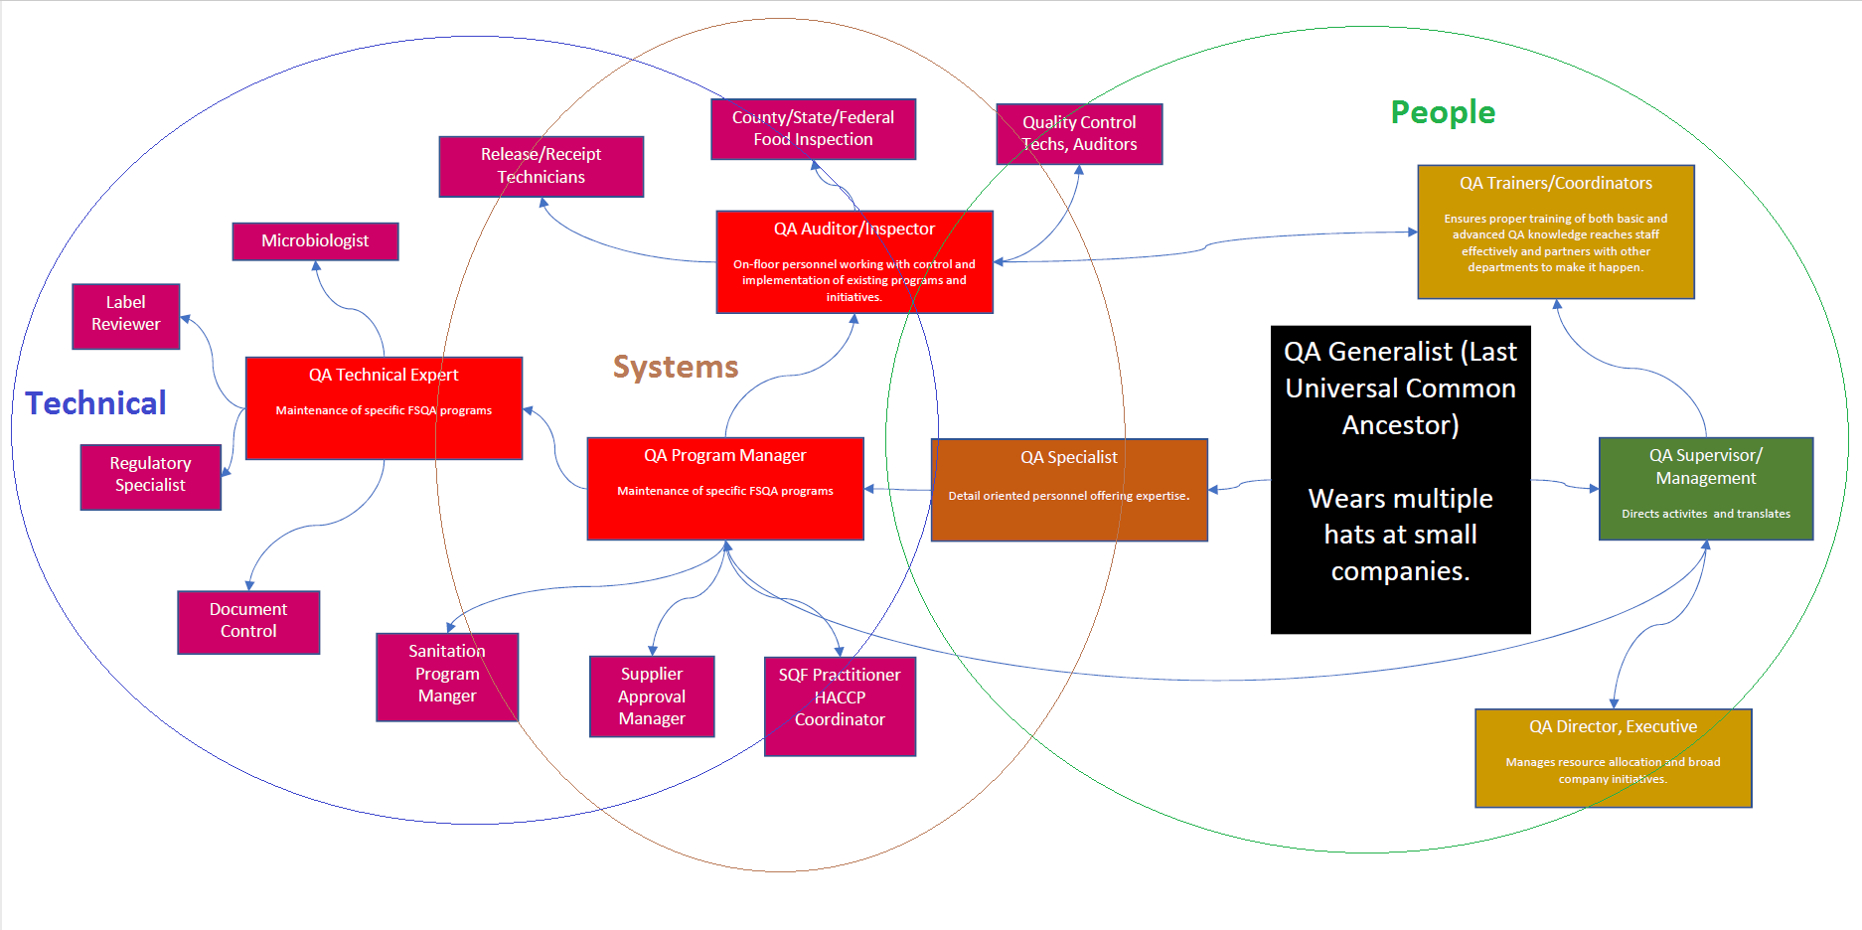
Notes:
I’ve had the privilege of working in a lot of different quality roles, like many folks I started out in highly technical positions like microbiology and label review, I’ve had supervisory and policy time working with the floor, and I’ve now been running my own quality program for the past 3 years at EartH2O.
I love what I do, but beyond the wonderful discussions we’ve had this week about keeping the food supply safe or trying to feed the world, anyone working in food safety or quality crashes against an unrelenting fact.

Slide 3
Managing Up
Yesterday we discussed making sure we have:
The right words
The right training
The right equipment
The “why”
The verification
…for the boots on the ground.

Slide 4
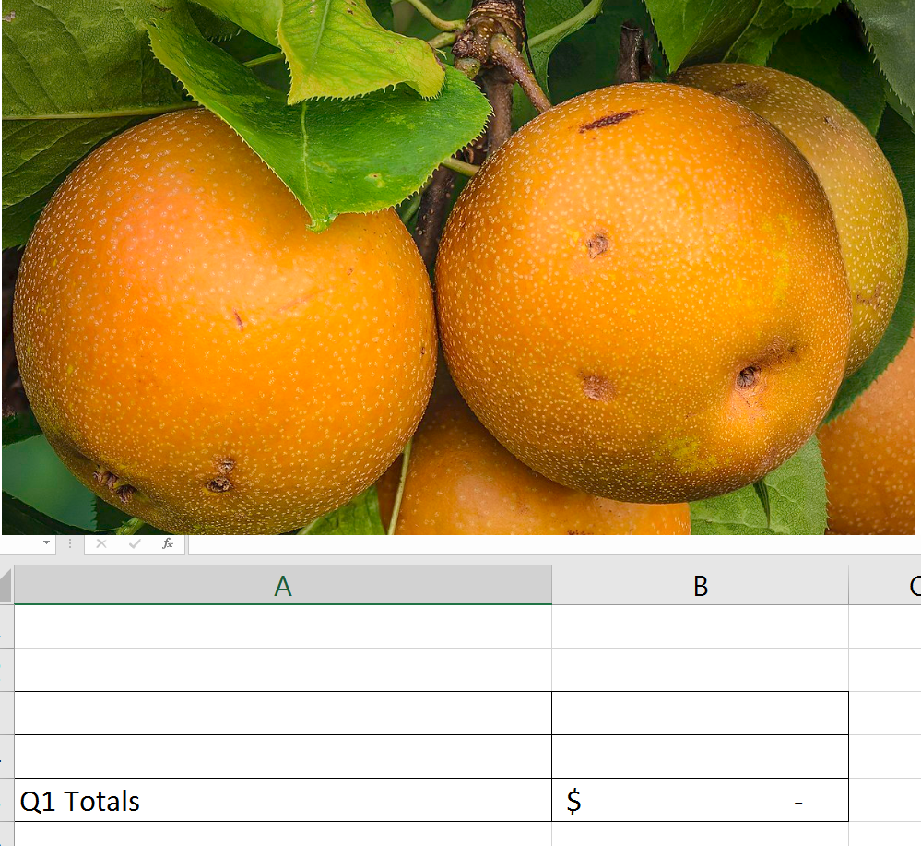
Food is, and will continue to be, a business activity.
Notes:
And as a business activity, it needs to be healthy, profitable, and continually improving it’s ability to do one thing, provide goods and services at a sustainable cost.

Slide 5
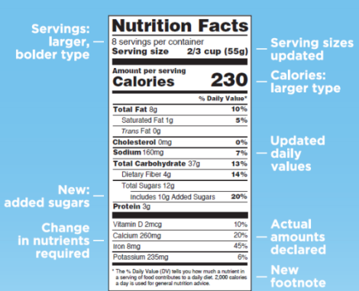
So, what makes us Lean?
Notes:
Many of you have probably attended Lean Six Sigma training that includes a lot of Japanese. As helpful as that is for making us feel credentialed following the training, it’s much more important to focus on the key elements of the philosophy.
A lean six sigma approach is constantly on the hunt for waste, either in capacity, people, resources, excessive/unnecessary activity, and specifically targets work performed that is not valued by the customer. At it’s heart we’re using systemic tools to focus on our highest priority areas for continuous improvement, and reduction in variation that leads to unpredictability.

Slide 6
So, what makes us Lean?
The elimination of waste:
Anything other than the minimum amount of equipment, materials, parts, space, and workers time, which are absolutely essential to add value to the product.
Notes:
The key word there is waste. So let’s define it.

Slide 7
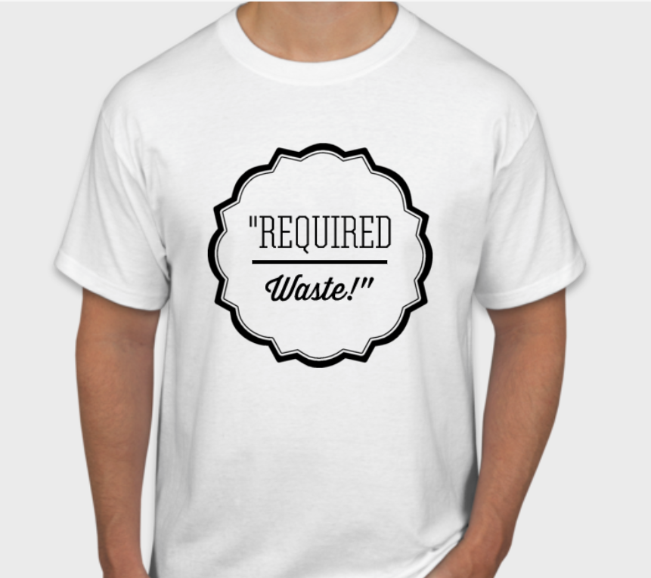
What does that make FSQA?
“Required waste”…
Best case scenario defense: perfect food safety culture.
Otherwise…Common, not so bad, arguments:
Preventing costly food safety events (the insurance argument/regulation argument/ethical argument)
Maintain certifications that open up customer markets (GFSI, Organic, Kosher…)
Inexpensive legal assistance (we’re keeping you out of trouble).
Notes:
My team is not going to be thrilled about their T-shirt swag this year.
Even for those of us running pilot facilities at one of the universities, the “perfect” food safety culture remains elusive. The best case scenarios are strong top level support, but there’s always going to be someone in the organization that doesn’t hold those values as high.
Which leaves us with the other common arguments for our existence (refer to slide):
I don’t like being considered a necessary evil as far as the bottom line is concerned. Unless you have had an accident recently, you don’t exactly get a warm fuzzy feeling whenever you pay for home or car insurance. I don’t want my company to feel that way about me. The numbers may make sense, but nothing exciting that is going to help it feel like an investment.
Maintaining certifications can definitely feel better, but as the goalposts continue to move these things continue to feel pre-requisite rather than an advantage. Everyone here working with big retailers can attest to keeping multiple schemes in place.
The last one may be true, but I also don’t always want to be the dentist shamefully telling you to floss. The CEO may know I’m right, but no one is not exactly psyched about the feedback. There’s only so much Parnell and DeCoster I can mention at every annual meeting.

Slide 8
The conclusion?
Quality Assurance and Food Safety is a necessary cost of doing business, like insurance, security, tax accounting, and legal…
…If we embody lean culture, it shouldn’t be this way.

Slide 9
Underutilization
QA teams are made up of analytical, scientific problem solvers with a principal goal: reduce risk of product defects/hazards in production processes.

Slide 10
Underutilization
QA teams are made up of analytical, scientific problem solvers with a principal goal: reduce risk of product defects/hazards in production processes.
If we determine where this goal collides with production goals, we’ve found opportunity.

Slide 11
Quality Goals Production/Sales Goals
Safe product.
Meet customer expectations
Risk management/continuous risk reduction
Non-safety based compliance
Safe people.
Efficiencies (availability and efficiency)
Waste reduction
Predictability/flexibility
Notes:
So let’s take a look at our top line goals across the organization.
On the quality side, obviously our number one goal is making sure that we’ve produced something safe and wholesome. No brainer.
Once that pre-requisite is complete, we work on “quality”. I like Brian Armentrout’s definition of the product “delivering what was promised”.
Then we hop into “where’s the next potential threat from” and do the quality thing of picking out that next piece of equipment, repair, validation that needs to happen.
In the middle we do things like argue over whether marketing copy is misleading, whether this particular customers version of truck inspections is met.
The production and sales side has a different viewpoint.
1st, and remember, this is another “culture” standard everyone is striving for, they want to keep the personnel safe.
Then we want to produce things as quickly as possible with the minimal amount of resources. This includes what we throw away.
Finally, the more predictable things are, the more efficient we can be. And when it can’t be predictable, we need to be nimble.

Slide 12
Why Quality isn’t helping with these goals
The requests are framed in a way that conflicts with our own goals.
“Do we have to clean every day”?
“This paperwork takes forever”
Notes:
Oftentimes when our production and sales teams reach out to us to help with their goals. They’re framed in such a way that our guard goes up. It smells of bad food safety culture, of a lack of appreciation for food safety, and the immediate feeling is to jump into that “required waste” defense of “it cost’s what it costs”.
If we’re going to support business goals without eroding our budding food safety culture, these initiatives need to be framed from a quality perspective.

Slide 13
Major Wastes
Defects
Overproduction
Waiting
Non-utilized staff
Transportation
Inventory/Storage
Motion
Extra Processing

Slide 14
Major Wastes – production perspective
Defects – it’s only a little out of spec
Overproduction – we don’t have enough changeover flexibility
Waiting – quality checks, calibrations, paperwork, decision making
Non-utilized staff – waiting again, lack of authority
Transportation – making us put things in designated areas
Inventory/Storage – holding raw materials
Motion – Checks, finding someone for sign off
Extra Processing - rework

Slide 15
Major Wastes – quality perspective
Defects – I don’t want to see them in the first place.
Overproduction – ambiguity, partials
Waiting – Lack of focus on inspection, GMP’s
Non-utilized staff – How can we make things better
Transportation – Eliminate cross contamination
Inventory/Storage - Traceability
Motion – Inefficient inspections – fast/poor inspections
Extra Processing – Rework means we already have bad product!

Slide 16
Keys to food safety employee compliance
Make it simple
Make it easy
Establish a culture where the bad behavior is abnormal
These are the same consistency principals followed in lean and 5S cultures.

Slide 17
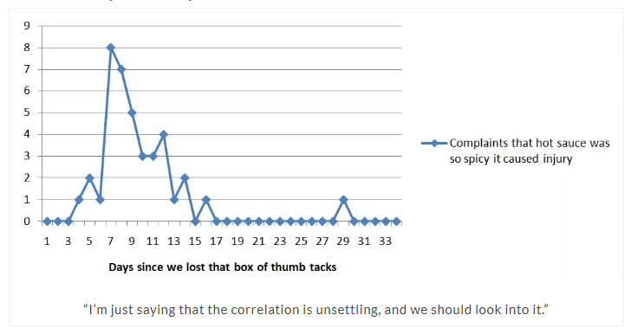
Utilizing your QA Team
Start with your data.
You cannot improve what you do not measure.
Product defect rates
Product holds
Pareto charts for product holds
Integrated data from multiple sources

Slide 18
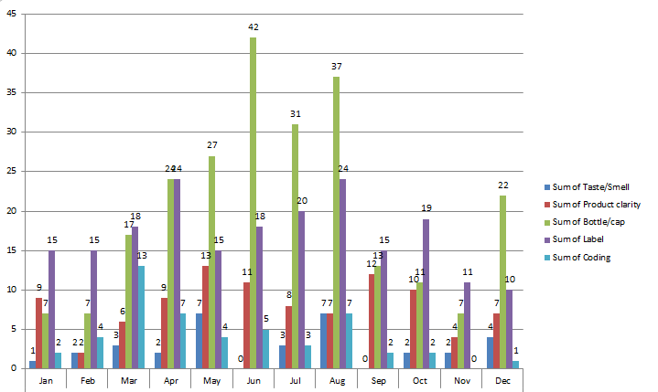
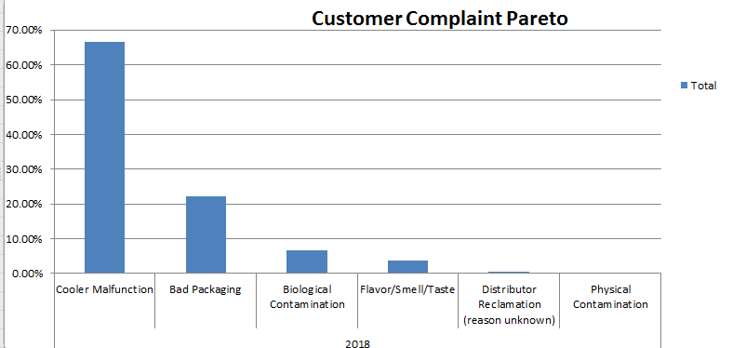
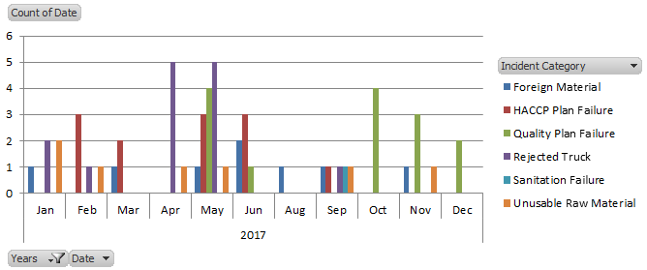

Slide 19
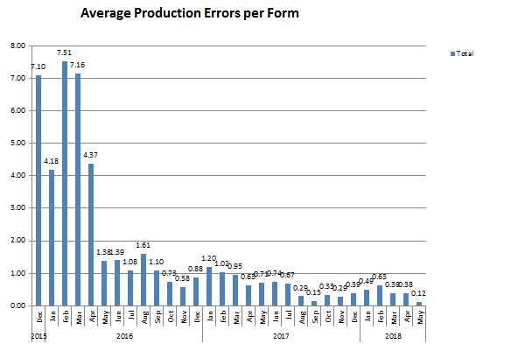

Slide 20
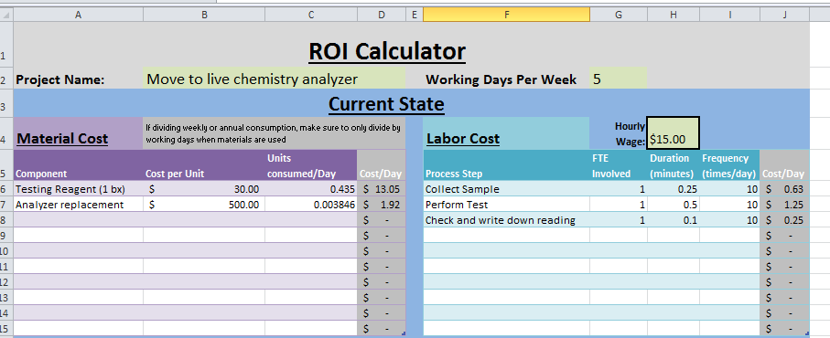
Say it with an ROI
https://furfarmandfork.files.wordpress.com/2016/01/austins-roi-calculator3.xlsx

Slide 21
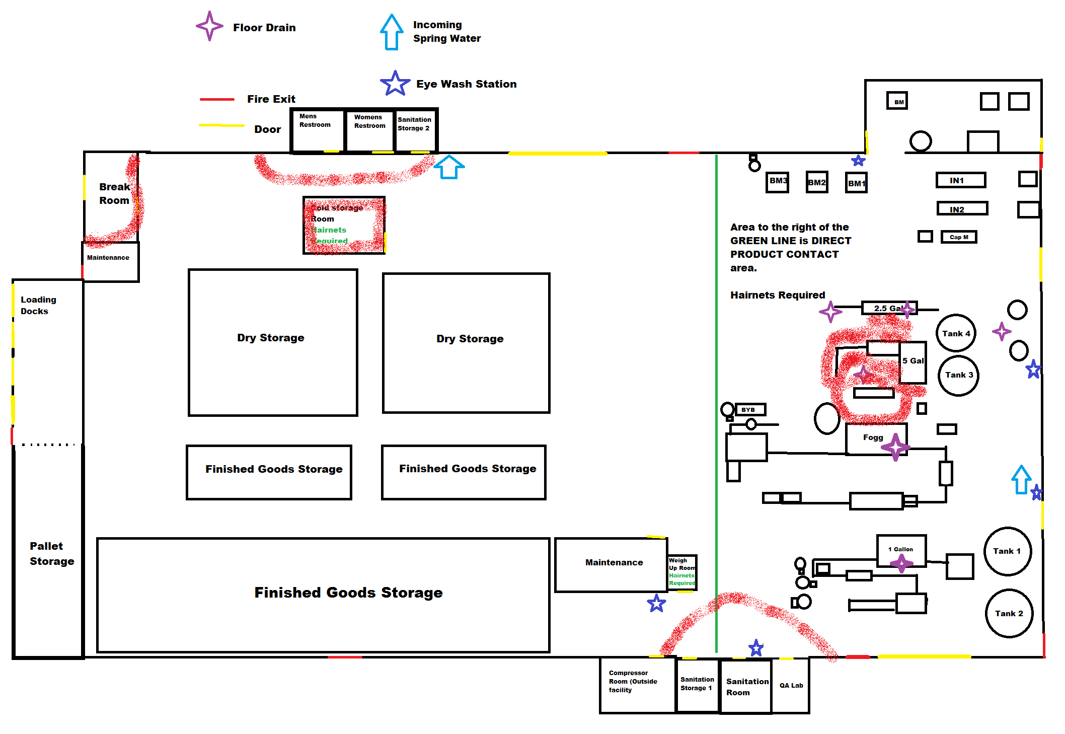

Slide 22
Sell the solution
Instead of something being caught by an auditor, or helping us reduce risk…
…how can I make our processes more efficient or consistent?

Slide 23
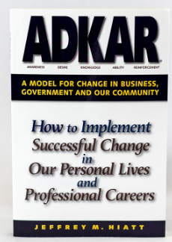
ADKAR
Awareness of the need for change
Desire to make the change (WIIFM)
Knowledge of how to make the change
Ability to make the change
Reinforcement of the change

Slide 24
Takeaways
Know that some arguments compelling to this group, are not so much to others.
Your annual audit is not my day-to-day problem.
Reframe production problems in ways that advance your quality goals.
“If the equipment was already clean and ready to go when the operators arrive, do you think we would start-up faster or run better?”
“Would it be easier for them to hop back-and-forth if there’s a problem if there was more space?”
“Would it be better if they didn’t have to stop to measure and write down all this stuff?”
Use the analytical talents of your QA team to generate useful data on quality performance and it’s relation to cost

Slide 25
What do you call a can full of comebacks?

Slide 26
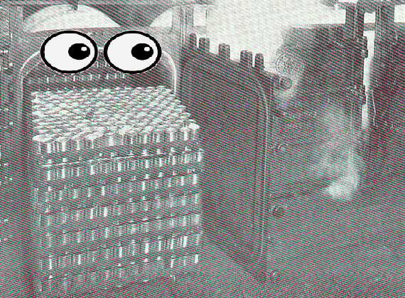
A witty retort.

