Slide 1
Training through Language and Culture Barriers
Nina G. Parkinson
WAFFP conference
September 20, 2018

Slide 2
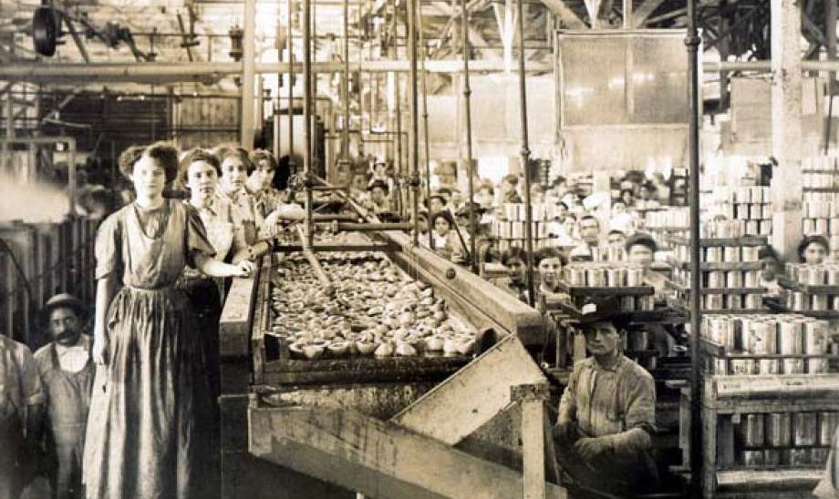
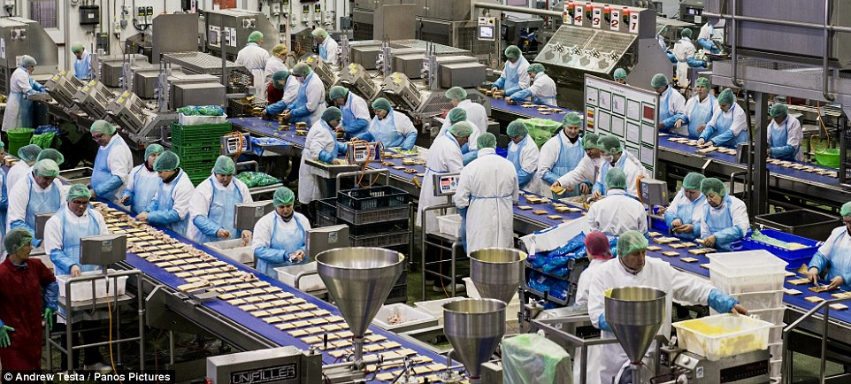
summary
Training through language and culture barriers
Why?
Regulations changed
Food production changed
Consumers changed
Workforce changed
But our training programs stayed the same!!

Slide 3
Regulations changed
21CFR110.10 (c) Education and Training
Food handlers and supervisors should receive appropriate training in proper food handling techniques and food protection principles and should be informed of the danger of poor personal hygiene and insanitary practices.
21CFR117.4 (general provision)
Receive training in the principles of food hygiene and food safety, including the importance of employee heath and personal hygiene, as appropriate to the food, the facility and the individual’s assigned duties.

Slide 4
Regulations changed
21CFR110.10 (c) Education and Training
Food handlers and supervisors should receive appropriate training in proper food handling techniques and food protection principles and should be informed of the danger of poor personal hygiene and insanitary practices.
21CFR117.4 (general provision)
Receive training in the principles of food hygiene and food safety, including the importance of employee heath and personal hygiene, as appropriate to the food, the facility and the individual’s assigned duties.

Slide 5
Regulations changed
Why?
Realization that people involved in ‘making food’ did not have a good understanding of the importance of their jobs

Slide 6
Food production changed
From ‘canned’ foods to ‘RTE’ and minimally processed and convenience foods
Global sourcing of raw materials and packaging materials
Different standards
The ‘attitude’ is starting to change
Production rules!

Slide 7
Consumers changed
More ‘sensitive’ consumers
allergies, sensitivities, elderly, immunocompromised
Lack of knowledge or understanding of food safety or food preservation
puts more responsibility on the producer

Slide 8
Workforce changed
Seasonal workers
Frequent turnover
Immigrants
different languages, cultures

Slide 9
Training programs
Became routine, mechanical
Usually upon hire and once a year afterwards
Mostly on ‘personnel practices’
Results:
Most people didn’t really understand ‘why’ they were doing things, just that they had to...
And many didn’t care…

Slide 10
Basics of Adult Education
But if you try to use these styles & approaches with people that:
Haven’t been in a classroom setting for a long time or ever
Have never taken a formal exam
May not understand your language
May not read or write
Have other concerns
Just want the paycheck
…It may not be very effective!
Different learning styles
Visual
Verbal
Tactile
Location
Timing
Test for comprehension

Slide 11
Determine objectives
Determine YOUR objectives for training/educational program
Comply with the regulations
Have an educated workforce that will be involved in improving your food safety program

Slide 12
What’s the difference?
Comply with regulations
The FDA has ‘elevated’ the whole training and education portion of their regulations to a general provision
They (and 3rd party auditors) will be checking your ‘training documents’ and may ask your workers questions to ‘verify’ they understand the information
May result in ‘going through the motions’ again

Slide 13
What’s the difference?
Have an educated workforce that will be involved in improving your food safety program
Increased awareness and participation of all employees to do things correctly all of the time
“Audit ready at all times”
“Food-safety culture”

Slide 14
Be ‘audit-ready’ at all times …
This level of confidence and standard of effectiveness requires:
Consistently high standard of practice
Effective systems for monitoring
Staff who:
fully appreciate the significance of maximizing food hygiene
value their role in the company
= COMMITTMENT

Slide 15
How do you do it?
Understand:
Difference between training and education
It will take time and money to bring your workers to a higher level
It will likely involve higher wages and benefits
And make a commitment ….. Don’t just go through the motions!

Slide 16
The Training Evolution
Training (skills)
Instruction (lecture)
Education
LEARNING
Getting people to think about a situation
Go beyond the materials presented
➔ Life lessons; react to different situations; critical thinking
➔ Behavior change!!
Adapt to new situations

Slide 17
Hierarchy of Training Investment Guidelines
Train what to do
Knowledge
10% of overall investment
Tools that work
Skill = how it’s done
20% of overall investment
Why!
Everyone wants to know
70% of overall investment!
10%
20%
70%

Slide 18
Start with a PLAN
Objective of training program
What do YOU hope to accomplish?
Who
Who will do the training?
Who will be participating?
What information will be presented?
When and how frequently will it be done?
Where will the training sessions take place?
How
How will the sessions be presented?
How will we know if they are successful?

Slide 19
Objective
Determine goal or objective in advance of each training session for the training program
What are you hoping to accomplish?
Comply with regulations
Develop workforce to be aware and mindful
Improve performance
Change bad habits
Encourage participation
Increased awareness
Worker ‘growth’ and development
Be ‘audit ready at all times’

Slide 20
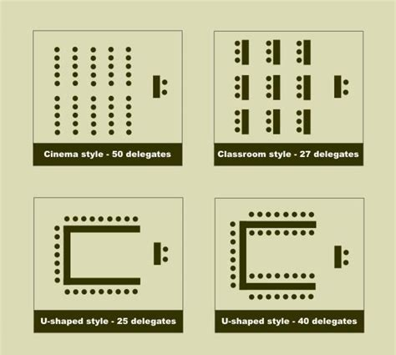
Where will it take place?
Provide appropriate venue
Comfortable
No distractions
Easy to make eye-contact
Classroom seating or U-shaped
Interactive
What I’ve seen!!
Picnic tables in break room area – outside, hot, windy, noise/birds
Conference room with bottled water and donuts served

Slide 21
When will it be presented?
Timing
Beginning of shift?
Break time? Lunch time??
Duration
Consider attention span, ability to sit, not how long will they be away from work?
Frequency
Upon hire?
Once a week? Every 2 weeks? Once per year??
Depends on your audience

Slide 22
Who will be involved?
Who will do the training?
QA Manager
FS Specialist
Outsider
Who will be the audience?
Break them into smaller groups, by responsibilities
Line workers
Sanitation workers
Maintenance workers
Supervisors
What language(s) do they speak?
Do they speak/understand English?

Slide 23
Language
Difference between ‘translating’ and ‘interpreting’
Example…
Differences within languages
Slang and regional expressions
What I’ve seen:
Simultaneous translations – something always gets ‘lost in translation’
Translation of written materials

Slide 24
Language - Suggestion
Identify someone who is a good communicator and speaks ‘their’ language(s) and have them help deliver the information.
Have them review the information and make sure they ‘understand the meaning’ prior to delivering the information.

Slide 25
Know your audience
Where do they come from?
What are their customs?
Do they eat the foods they make?
Do they understand your objectives, concerns?
Why do they work at your facility?
To get a salary in order to survive? So you have to make them care about food safety!
Are they seasonal workers who will likely never come back?
Do they have any interest/desire to advance?
Do YOU want them to ‘advance’ → more $$

Slide 26
Understanding the Audience
Adults are goal-oriented
Need to know why they’re there and “what’s in it for me” (WIIFM)
How does it pertain to my job?
How does it pertain to my life?
Want information to be pertinent
Defined learning objectives – the “why”
Need to apply learned information ASAP
Need to have information presented in organized and concise manner
Need to feel respected!

Slide 27
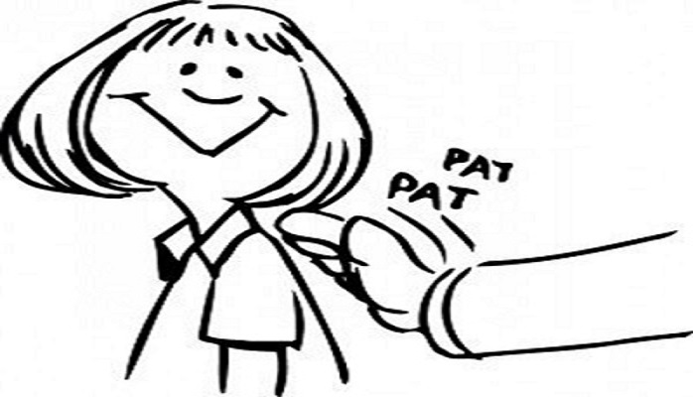
Respect your audience
No matter what their age, education level, gender, language abilities, etc. they must feel respected in order to open their ears/mind to what you’re saying!
Establish a relationship with them
Get to know them
Give them positive feedback when they do something correctly (everyone likes ‘a pat on the back’!!)
Understand that some may be very shy or modest/humble and actually may appear to be ‘afraid’ of you (authority figure), this may breed the idea that they only have to do what you say when you are watching!

Slide 28
Strategies for all adult learners
Treat learners as equals
Treat learners as individuals, not as a group
Listen to their perspectives
Establish a climate of collaboration rather than competition or arguments or defensiveness
If people feel they are being patronized, offended, etc., they will focus their energy on dealing with those emotions rather than learning the material

Slide 29
Learn while you teach
Ask them what they understand (or don’t) about what you’re explaining
If you ask, ‘do you understand’ how do you think they will respond?
They may have learned or understood something differently about what you’re saying, which will make it difficult to accept your information. You may need to clear that up before going further
Washing hands with cold water causes arthritis!!

Slide 30
Change
Old habits are hard to break
Resistance to change (attitudes, actions, behaviors)
Need to explain ‘why’ and ‘how’
May need help in prioritizing new assignments

Slide 31
What will be presented?
GMPs – it’s more than personal hygiene!
Regulations and company policies
Food Safety principles
Sanitation
SOPs
Recordkeeping

Slide 32
How will it be presented?
Lecture
Notes, handouts
PowerPoint
Videos
Games
Discussion

Slide 33
What I’ve seen
Poorly organized training session, no real interest in the materials, ad-libbed examples, no focus, no purpose.
Prepared PowerPoint presentation read to all participants at a fast pace, no explanations, no stories, and a sign-up sheet passed around at the end.
→ Interactive training session with a lesson plan, examples, questions and activities to get everyone involved.

Slide 34
Key points
Maintaining or increasing a sense of self-esteem and pleasure are strong secondary motivators for learning
Creative and innovative programs
Appeal to a person’s sense of pride
Incorporate the principles of food safety in an understandable manner
Notes:
From B. Gravani; Portland Sanitation Workshop, 2014

Slide 35
How will we know if we were successful?
Exams
Group exercises with discussions
Performance

Slide 36
Checking for comprehension
Written test – may not work for everybody!
You have to come up with questions that make sense, are fair and worded/translated properly! What if they fail??
Consider that some people are not familiar with T/F or multiple choice tests
Some adults ‘freeze’ when given a test and will tend to cheat
Make it a group exercise, where they have to discuss the answers? Improve their critical thinking skills
Pre and Post Tests
Pre-test usually lets them know what’s going to be important and they may pay closer attention to some details in the presentation!!
Post-test (hopefully) gives them a better score, so they feel like they learned something!

Slide 37
Checking for Comprehension
Prepare questions to ask during the presentation and listen to their responses.
Repeat the correct answer so everyone hears it.
If someone responded incorrectly, explain why that was not correct, without offending!
Demonstration, if appropriate
Best way to gauge learning is to teach!!
Have students explain and/or show what they just learned to someone else
After the session, observe them for changes in behavior, or lack thereof …bring it up next time!

Slide 38
Records
Important to document training session
Objective of the training session
When – date, time, length of training (start/end time)
Who did the presenting and who attended (name, signature, ID #)
What information was given; copy of presentation
How was it delivered? Lecture, demonstration, etc.
How was proficiency evaluated? Summary of results
Observations (to be used for continuous improvement)

Slide 39
Measuring success
Decreased deviations
Decreased consumer complaints
Decreased investigation
Increased up time
Increased first pass quality
Improved audit scores
Employee engagement

Slide 40
The Hazards of a Weak Food safety Culture
Good practice stands on a strong, pro-active culture of food safety
Where it is lacking, there are likely to be:
high rates of customer complaints
a disinterested workforce with
poor rates of pay
high absenteeism and staff turnover
unhygienic conditions

Slide 41
Top 10 Causes of Recalls
Recalls by Specific Processor Problems (FDA)
Incorrect packaging/labelling 66%
Ineffective employee training 32%
Failure to follow processing SOP 26%
Contamination of raw materials 9%
Excess/Mistaken addition of chemical and/or ingredients 8%
Ineffective use of sanitation principles 6%
Unknown 4%

Slide 42
Obstacles
Overly strict food safety monitoring can undermine confidence and motivation.
Staff can become worried their every move is being scrutinized and they are not trusted.
There is a fine balance between judging individual performance and helping teams to understand why checks are necessary despite a busy schedule.
Sanitation inspection and swabbing may be viewed as adversarial. Need to change the mindset.
Keeping employees engaged and energized is a vital challenge.

Slide 43
Change
Corporate culture favors the status quo; change in management is difficult.
The transition to a food safety culture CAN happen incrementally.
Rushing through extensive changes can be “detrimental” and thus counter-productive.
Behavior-based approach involves a number of key considerations

Slide 44
Key considerations
You can’t do everything at once!
Take a few of the more serious issues and work on improving them first.
Look at the training program in relation to everything else is a way to move forward without getting overwhelmed.
Communicate – to all employees through all channels available – trainings, notice boards, and on an everyday basis by providing positive feedback (let them see you!)
Can only be developed when everyone understands that everyone plays a role!

Slide 45
Culture is Significant
It defines right and wrong:
written and unwritten rules
procedures and guidelines
established protocols and informal processes
salaries and perks and more
Determines how staff behave and whether they follow or undermine the rules
in turn, staff behavior reinforces the culture
it’s an on-going feedback loop

Slide 46
Questions? https://www.youtube.com/watch?v=SxqwXNfYmOQ
Thank you!!

