Slide 1


An Introduction to Aquaponics
Dr Gleyn Bledsoe
Gleyn@wsu.edu

Slide 2
Hydroponics
Growing plants without soil
Uses nutrient solutions in water.
Terrestrial plants can grow with only their roots exposed to the nutrients
On occasion, the roots may be supported by an inert medium such as coir, perlite or even gravel
The nutrients used in hydroponic systems can come from an array of different sources including
  Fish waste
  Poultry manure
  Chemical fertilizers

Slide 3
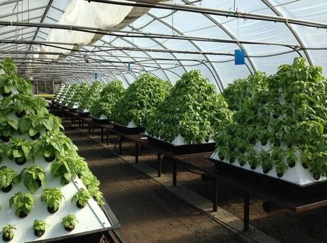
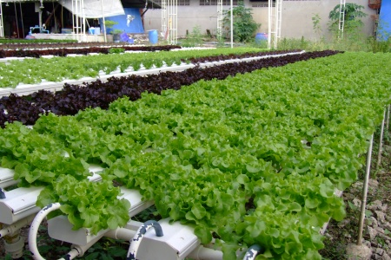
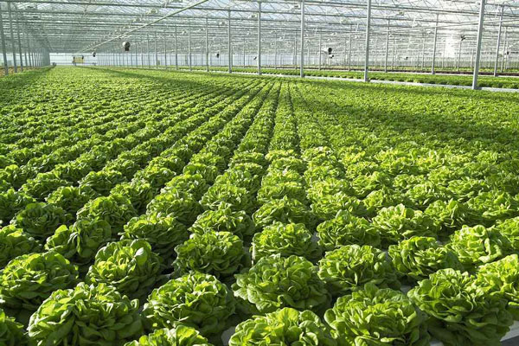
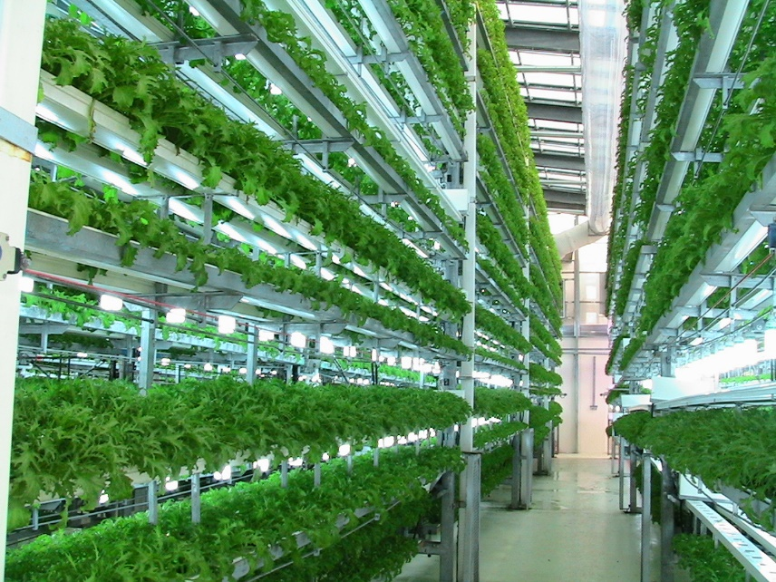

Slide 4
What is Aquaponics
Aquaponics is a combination of growing both fish and plants in a single ecosystem.
Combination can also include crustaceans or algae.
Water that has been fertilized by the fish flows to the plants that take-up needed nutrients.
Bacteria are used to transform the fish respiratory waste into nutrients for the plants.
In a Recirculation Aquaculture System (RAS) coupled system:
  plants cleanse the water
  Water is returned to the fish
  This allows to grow fish and plants with the same volumes of water and without wasting water as it continues to circulate.

Slide 5
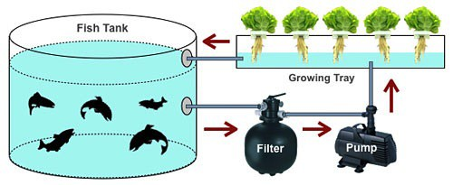
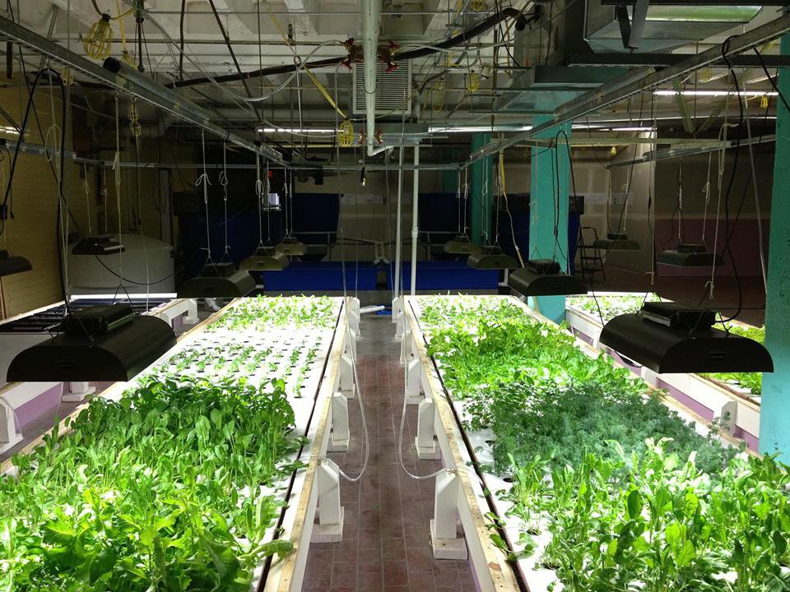
A Simple Aquaponics System

Slide 6
The Nutrient Exchange is
Facilitated by Bacteria
Fish discharge ammonia which can become toxic in a RAS system
The plants require nutrients such as Nitrogen
Nitrosomonas bacteria convert the potentially toxic ammonia into nitrites
Nitrospira bacteria convert the nitrites into plant bio-available nitrates.

Slide 7
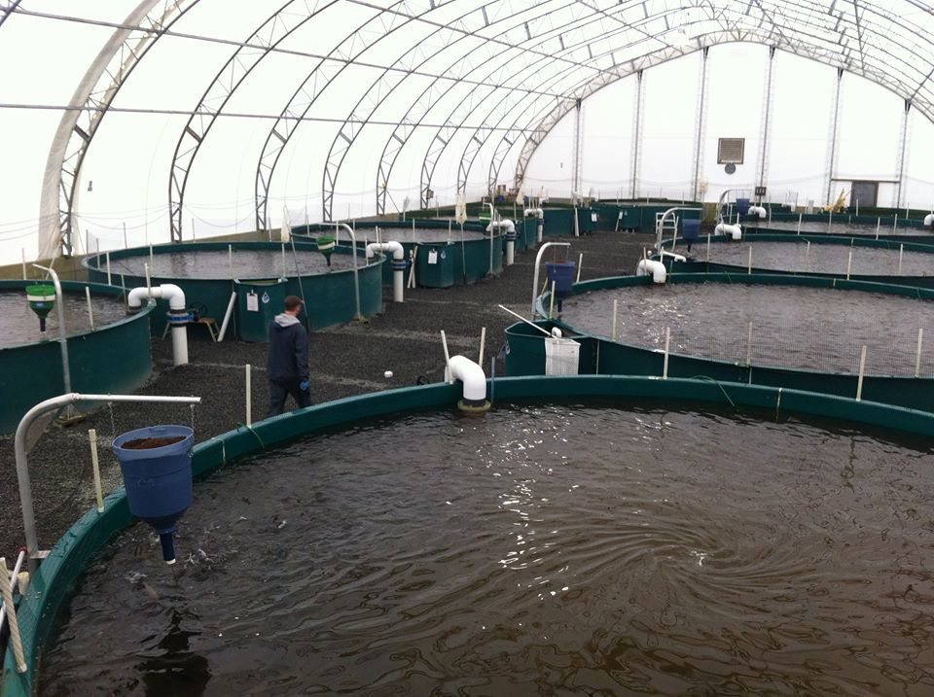
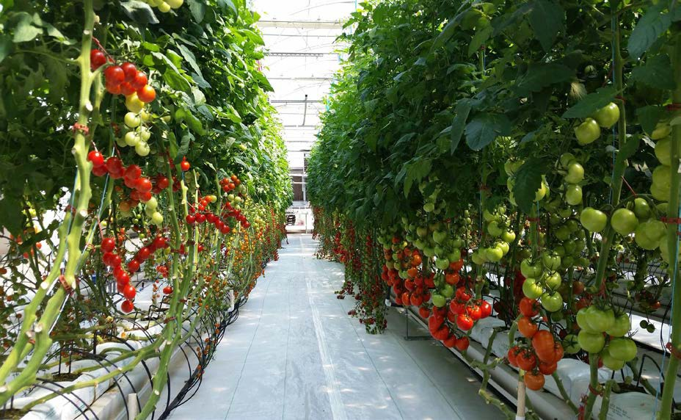
SUCCESSFUL AQUAPONIC SYSTEMS MAXIMIZE THE BEST OF BOTH PRODUCTION SYSTEMS
AQUACULTURE HYDROPONICS

Slide 8
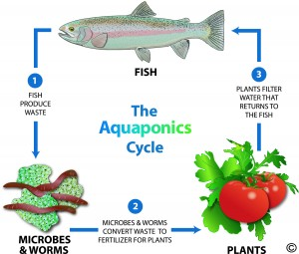
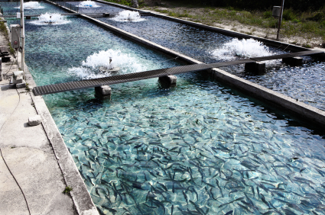
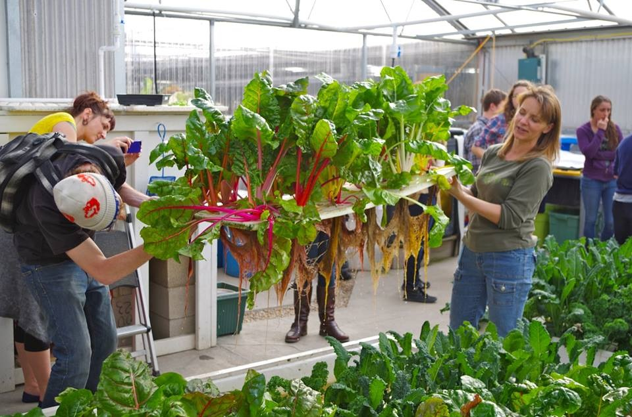
Aquaponics combining systems

Slide 9
Decoupled Aquaponic Systems (DAPS)
DAPS provide independent control over each system unit (i.e. RAS, hydroponics, and nutrient recovery via sludge remineralization).
In DAPS, fish and plants have individual and independently controlled water cycles.
DAPS also provide better growth conditions for both fish and plants and avoid additional discharge.

Slide 10
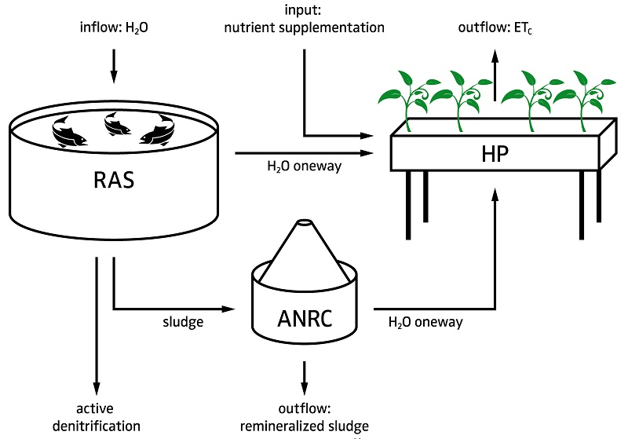
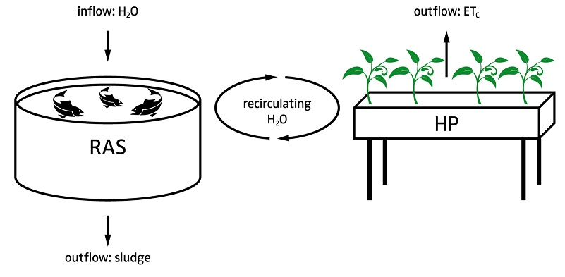
Decoupled vs Coupled Systems

Slide 11
Aquaponics Advantages Over Traditional Agricultural
Year-round crop production.
Eliminates agricultural runoff.
Reduced water consumption.
Reduced or no use of pesticides.
Significantly reduces use of fossil fuels for farm machines.
No weather related crop failures.
Offers the possibility of sustainability for urban centers.
Makes use of abandoned or unused properties.
Reduces distance in transportation to market.
Increases shelf life at point of purchase.
Reduces loss rate due to spoilage.

Slide 12
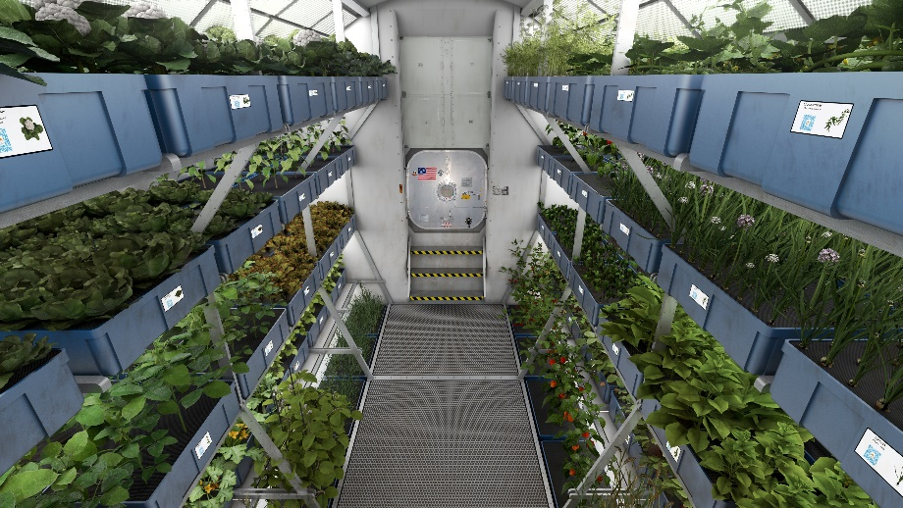
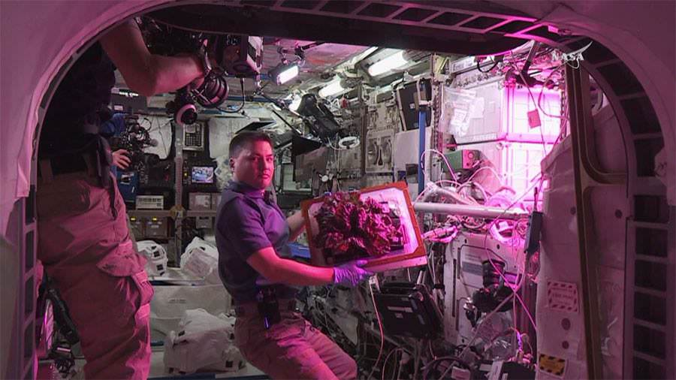
May be the Solution for Sustainable Food Systems for many Unique Locations
Space Station/Mars Mission Application Study
Kjell Lindresen on ISS, 8/10/2015
Source: www.nasa.gov , and www.universetoday.com

Slide 13
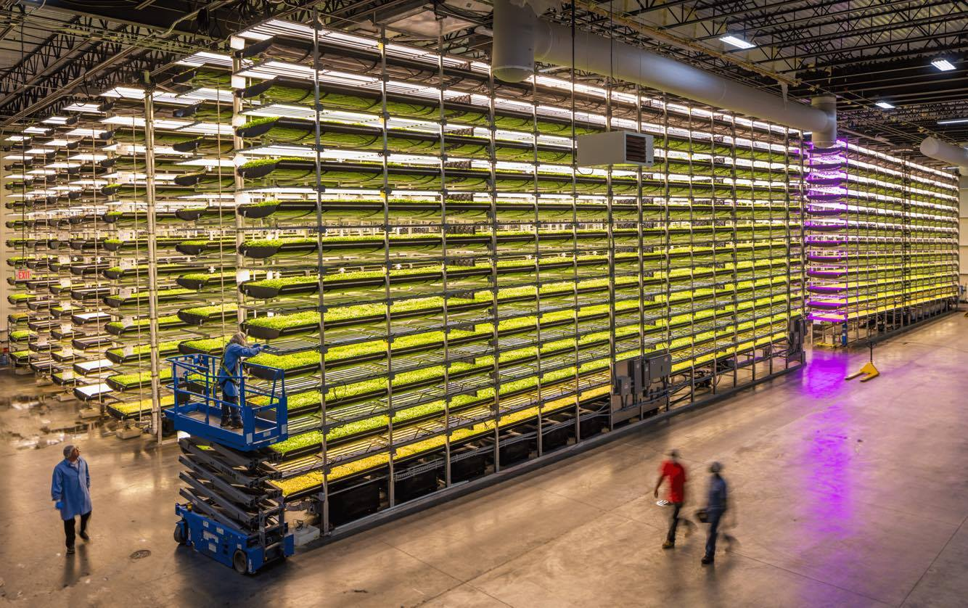
AeroFarms – Newark, NJ
Multi Layer – horizontal grow systems
(Funding $30 million to date)
Source: www.aerofarms.com

Slide 14
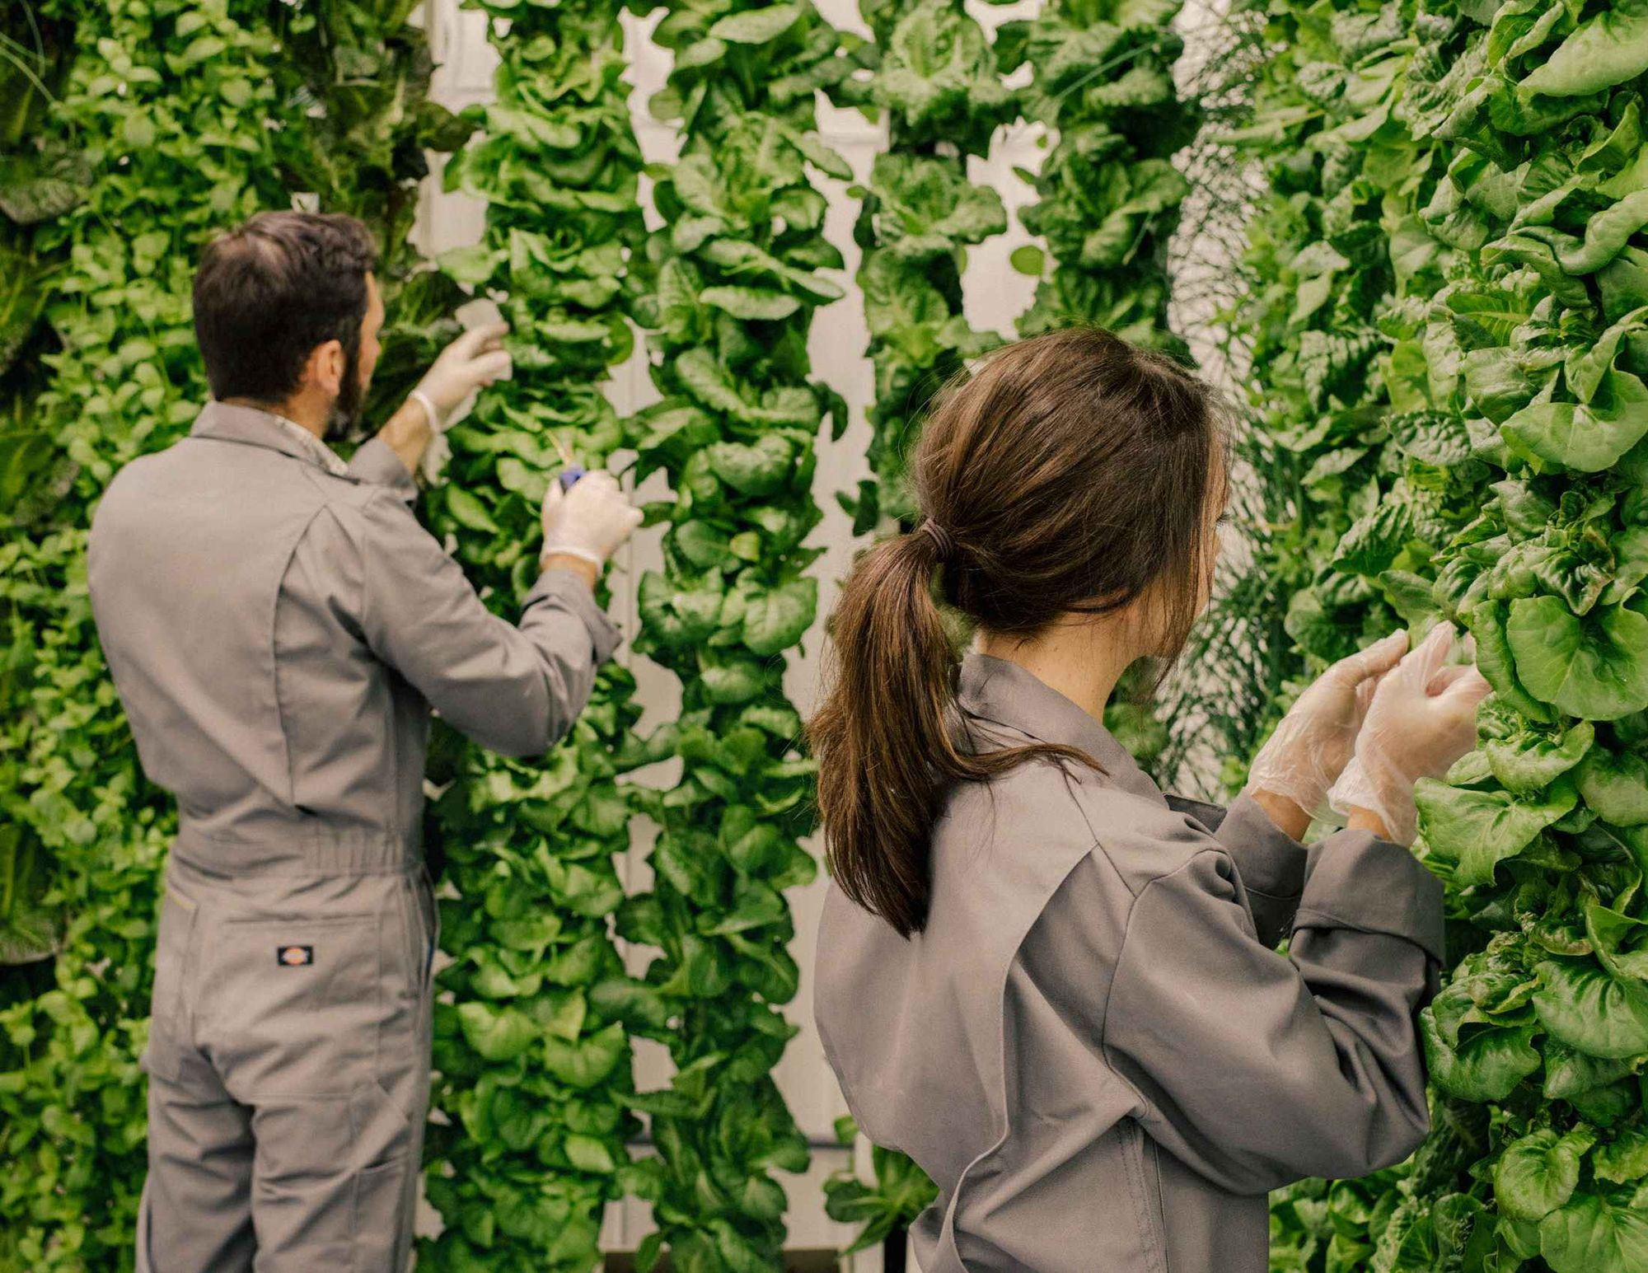
Plenty, Inc. – South San Francisco, CA www.plentyinc.com Vertical Grow Systems
(Funding $224 million to date)
Source: www.Bloomberg.com

Slide 15
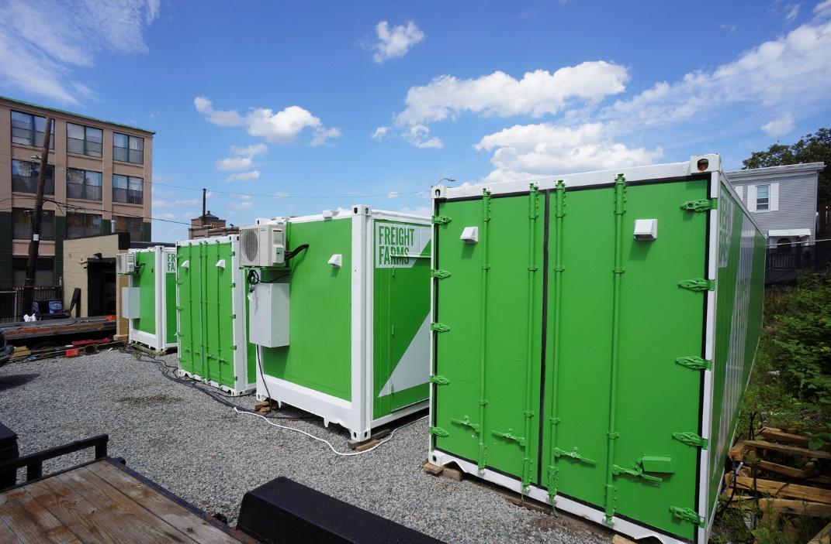
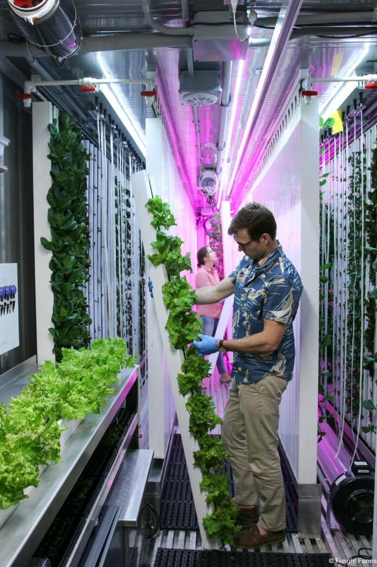
FREIGHT FARMS BOSTON, MASSACHUSETTS www.freightfarms.com
Vertical Grow Systems in 40 ft containers
Source: www.freightfarms.com

Slide 16
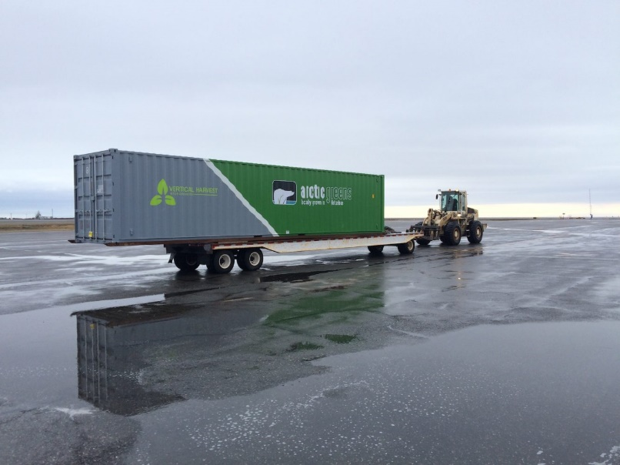
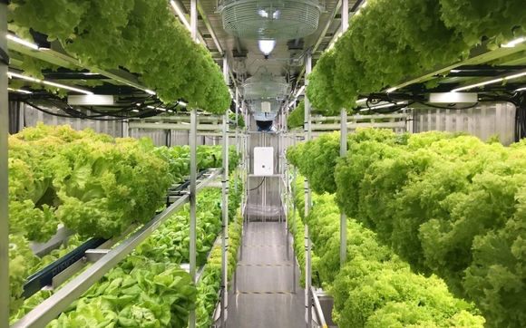
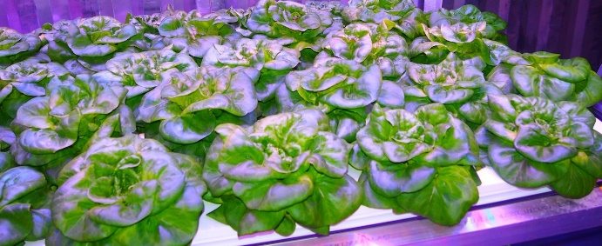
VH Hydroponics Anchorage, Alaska
Dutch Harbor Fresh Produce
40’ CONTAINER – INTEGRATED SYSTEMS CAN GENERATE
450 HEADS OF LETTUCE/ WEEK
1,800 HEADS OF LETTUCE/MONTH
24,000 HEADS OF LETTUCE/YEAR
www.vhhydroponics.com

Slide 17
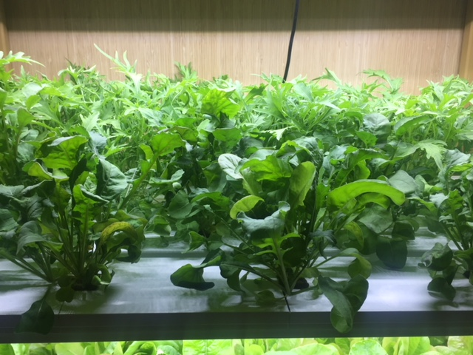
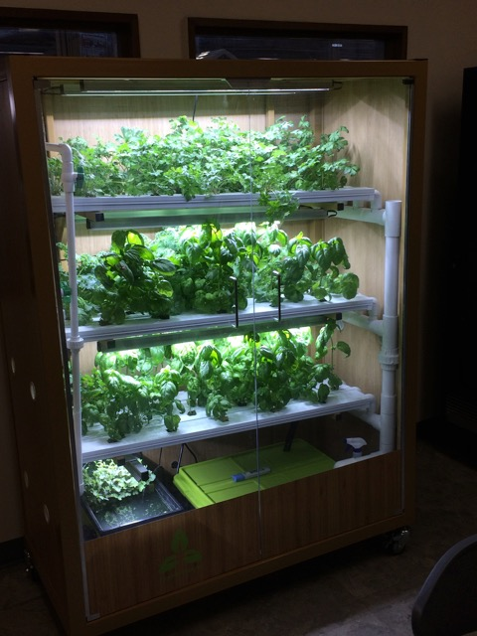
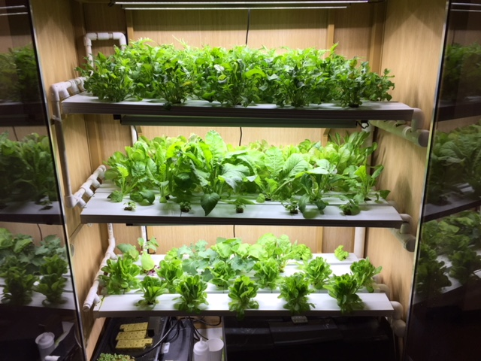
CAFT Office Everett

Slide 18
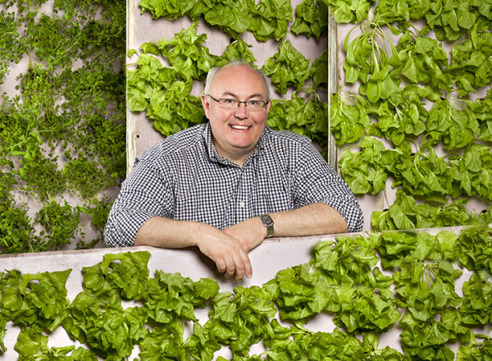
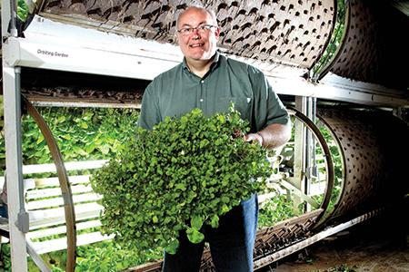
Garden Fresh Farms – St. Paul, MN
Vertical (greens) and Cylindrical (herbs) Growth Systems www.gardenfreshfarms.com
Source: www.minnesotabusiness.com, www.earthtechling.com

Slide 19
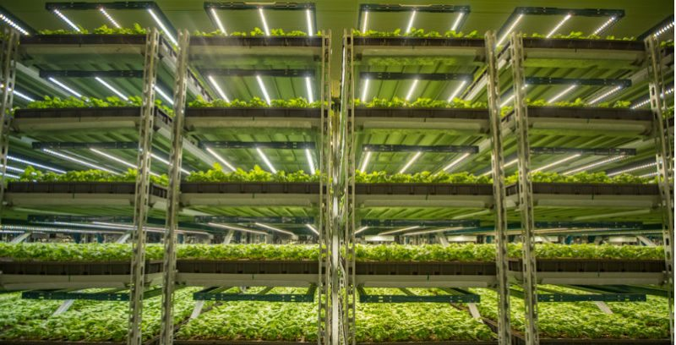
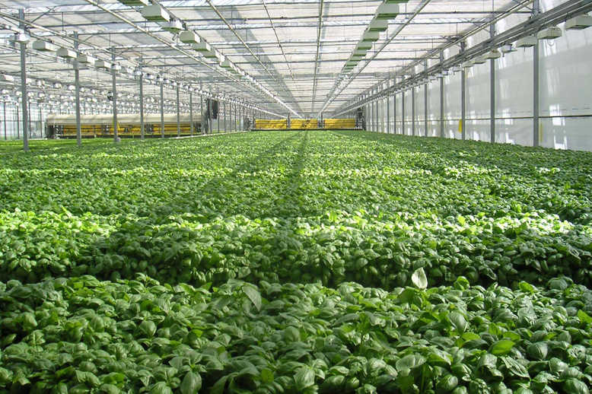
Shenandoah Farms, Harrisonburg, CA www.shenandoahfarms.com multi level horizontal nursery and small pot greenhouse growing of cut & live herbs
Source: www.gpmag.com
Source: www.supplychaindigital.com

Slide 20
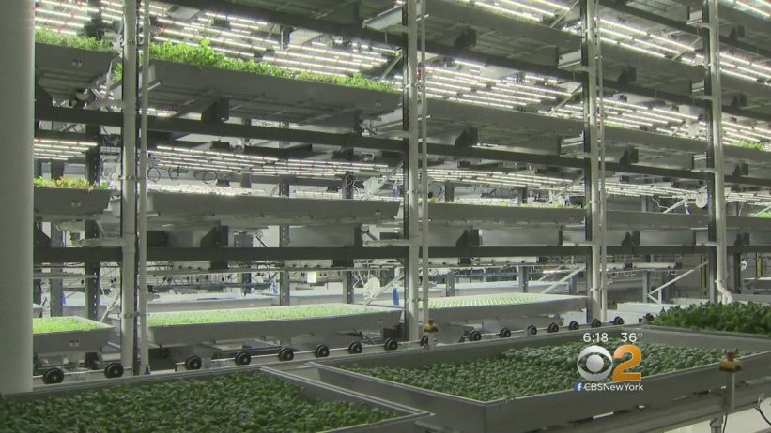
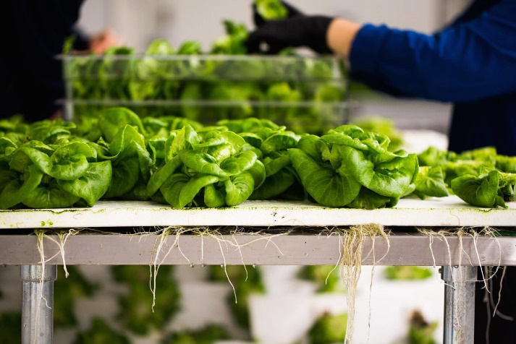
Bowery Farming – New York, NY www.boweryfarming.com
Vertical tray growing
(Funding $31 million to date)
Source: www.newyork.cbslocal.com
Source: www.ilikeitraw.com

Slide 21
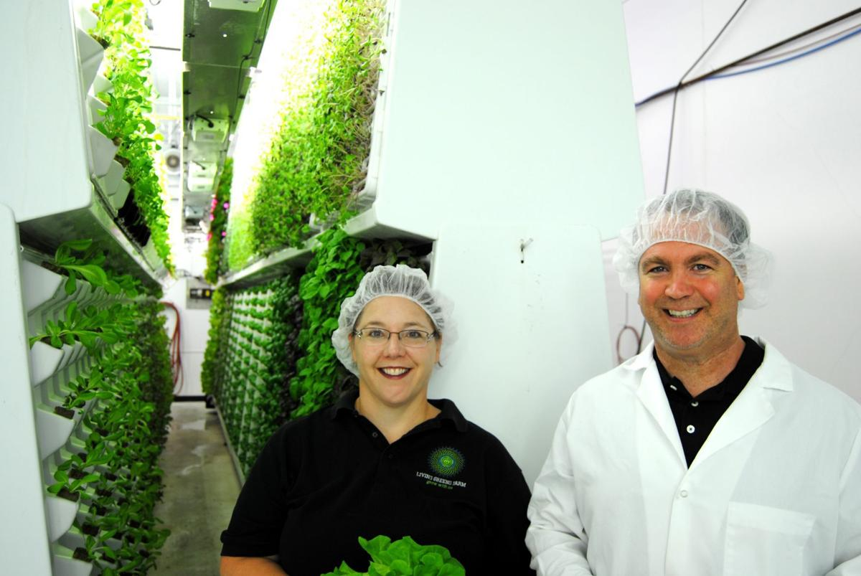
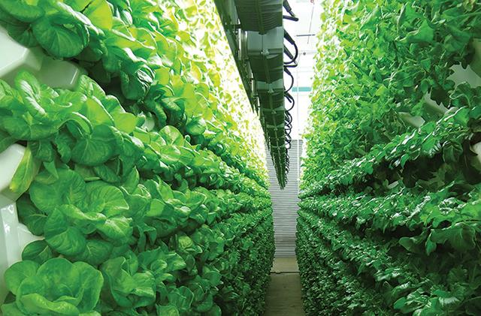
Living Greens Farms – Faribault, Minnesota www.livinggreensfarms.com
Pyramid growing sheet, vertical growing
(Funding $14 million to date)
Source: www.southern.com
Source: www.minnpost.com

Slide 22
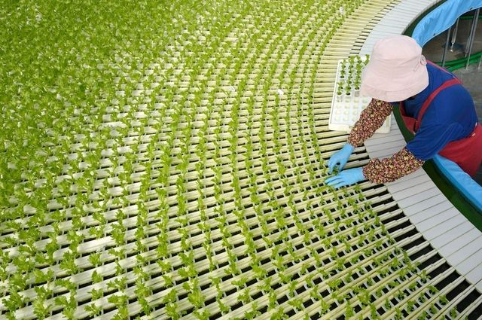
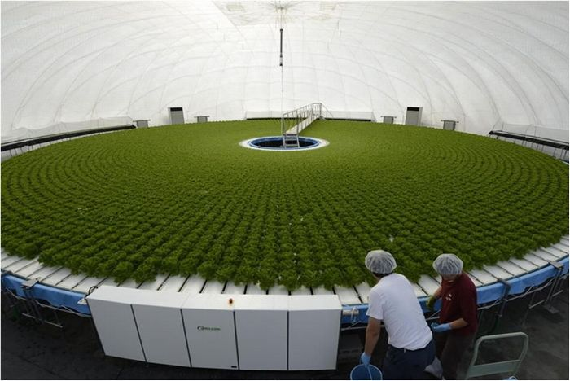
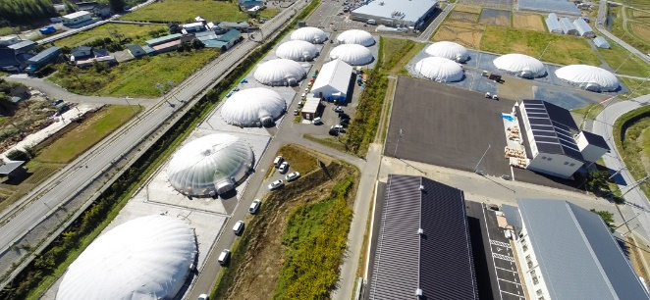
Granpa Systems Engineering – Japan
Dome covered, rotational growing chamber, 15,000 plants in 30 days; continuously transplanted and harvested in 65 ft. dia. water tank https://granpa-se.co.jp/
Source: http://verticlefarm/altervista.org
Source: https://granpa-se.co.up/

Slide 23
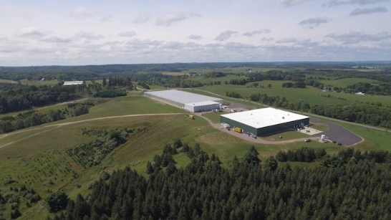
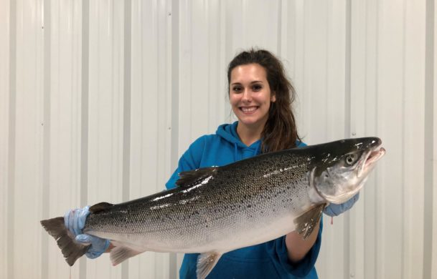
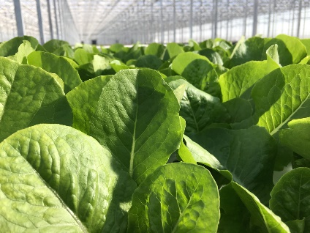
Superior Fresh – Blair, Wisconsin www.superiorfresh.com
Privately funded to nearly $100 million
720 Acres of land; 123,000 Square Feet Glass Greenhouse producing/year:
120,000 lbs Atlantic Salmon
- 40,000 lbs. Rainbow Trout
1.8 million lbs. fresh greens
Source: www.superiorfresh.com and Superior Fresh Company

Slide 24
Food Safety Considerations
Two food safety systems
  Seafood HACCP
  Produce Safety Plan
SFS has developed a Model Food Safety Plan for Aquaponic Systems
Aquaponics Workshop at SFS training Center in Everett – Sept 25 & 26, 2018

Slide 25
Summary
Aquaponics is a growing, commercially viable industry
Reduces pesticide & herbicide requirements
Reduces labor input requirements
Reduces microbiological hazard risks
Reduces transportation costs
Produces a sustainable sources of protein, produce, herbs as well as ornamentals

Slide 26
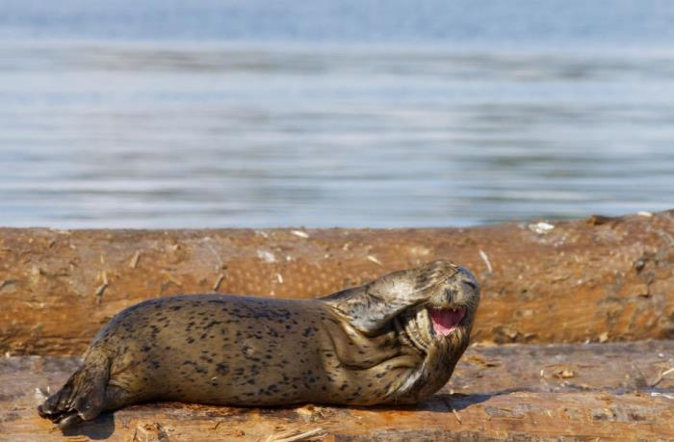
Questions?
http://sfs.wsu.edu/caft/
Gleyn@wsu.edu

