Slide 1
Washington Food Protection Association Chelan, WA 9/20/2018 Claudia G. Coles – WSDA Policy & External Affairs Advisor ccoles@agr.wa.gov
Know Your FSMA Food Safety Risk

Slide 2
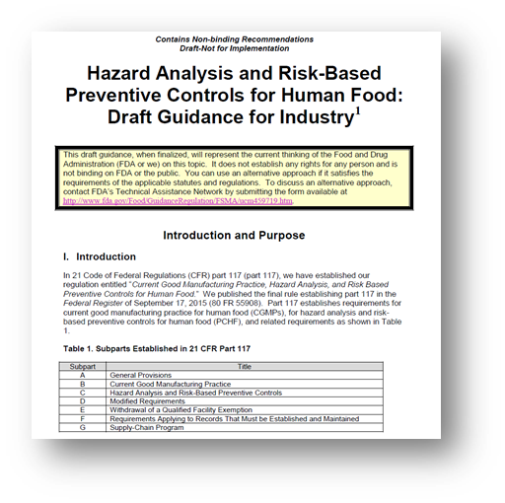
FDA’s Hazard Analysis and Risk-Based Preventive Controls for Human Food – Draft Guidance for Industry
https://www.fda.gov/Food/GuidanceRegulation/GuidanceDocumentsRegulatoryInformation/ucm517412.htm

Slide 3
Objectives
Purpose and Scope of draft Preventive Controls for Human Food (PCHF) Guidance
Describe the structure of the draft PCHF Rule Guidance to Industry document
Highlight Key Content from Guidance
Describe how to use the Guidance specifically Appendix 1 to conduct a hazard analysis
Notes:
The purpose of the food hazards guide is to help a food facility develop a food safety plan (FSP) in accordance with the requirements of the PCHF Rule and to facilities in identifying potential hazards, deciding if they are significant, and what control strategies might be available to mitigate the hazard.

Slide 4
PCHF Draft Guidance Introduction
Key Content
Summarizes the requirements of the PCHF Rule
Support compliance to the requirements of Subparts C & G
Provides a Glossary of Terms
Provides tables in Appendix 1 that are intended for use in considering potential hazards
Note: The PCHF Guidance is draft and once finalized will represent the current thinking of FDA on this topic. It does not establish any rights for any person and is not binding on FDA or the public. You can use alternative approach if it satisfies the requirements of the applicable statues and regulations.

Slide 5
Purpose of PCHF Guidance
To help a facility develop a food safety plan (FSP) in accordance with the requirements of the PCHF Rule (Subpart C and G) of part 117:
A written food safety plan (FSP);
Hazard analysis;
Preventive controls;
Monitoring;
Corrective actions;
Verification; and
Associated records.
Notes:
Purpose
This document is directed to those persons (you) who are subject to the PCHF requirements of part 117). Establishing risk-based preventive controls enables you to apply a proactive and systematic approach to your food safety program through the establishment of preventive controls designed to protect your food, and the consumer, from biological, chemical (including radiological), and physical hazards. Risk-based preventive controls will not give you a "zero-risk” system for manufacturing, processing, packing, and holding food; rather, risk-based preventive controls are designed to minimize the risk of known or reasonably foreseeable food safety hazards that may cause illness or injury if they are present in the products you produce.

Slide 6
Guidance Provided on PCHF Rule Subpart C
Understanding the biological, chemical (including radiological) and physical hazards that are commonly of concern in manufacturing, processing, packing, and holding of FDA-regulated food products;
Understanding the components of an FSP and the importance of each component;
Understanding how to conduct a hazard analysis and develop an FSP for the products that you process;
Understanding how to identify control measures for common biological (specifically bacterial pathogens), chemical, and physical hazards associated with many processed foods so you can apply those controls to the hazards identified in your hazard analysis;
Understanding how to identify and apply the preventive control management components (i.e., monitoring, corrective actions and corrections, and verification); and
Understanding the recordkeeping requirements associated with the FSP and implementation of the FSP.
Notes:
Highlight key content to be noted.

Slide 7
PCHF Guidance Structure
Chapter | Subject | Status | Issued
1 | The Food Safety Plan | Draft | August 2016
2 | Conducting a Hazard Analysis | Draft | August 2016
3 | Potential Hazards Associated with the Manufacturing, Processing, Packing, and Holding of Human Food | Draft | August 2016
4 | Preventive Controls | Draft | August 2016
5 | Application of Preventive Controls and Preventive Control Management Components | Draft | August 2016
Notes:
Now let’s take a look at how the guidance was structured. Let’s look at the Table of Contents for the Guide.
In understanding “How to Use This Guidance”, the content found in the first 5 chapters of the guidance should be considered as the foundational “Reference” Chapters.
These foundational reference chapters and their accompanying Appendices which we will review in a coming slide provide guidance for writing a food safety plan (FSP), including preparing a written hazard analysis to determine which hazards need a preventive control.

Slide 8
PCHF Guidance Structure
Chapter | Subject | Status | Issued
6 | Use of Heat Treatments as a Process Control | Draft | August 2017
7 | Use of Time/Temperature Control as a Process Control |  | Coming soon
8 | Use of Formulation as a Process Control |  | Coming soon
9 | Use of Dehydration/Drying as a Process Control |  | Coming soon
10 | Sanitation Controls |  | Coming soon
11 | Food Allergen Controls |  | Coming soon
12 | Preventive Controls for Chemical Hazards |  | Coming soon
13 | Preventive Controls for Physical Hazards |  | Coming soon
14 | Recall Plans |  | Coming soon
15 | Supply-Chain Program | Draft | January 2018
Notes:
In understanding “How to Use This Guidance”, the content found in the next 9 chapters of the guidance (i.e. Chapters 6-14) should be considered as the “Practical Example” of control strategies. These chapters will take you through the application of various preventive controls to various processes designed to be representative of small and medium size firms.
These are currently under development and the anticipated publish dates on these subsequent chapters are FY 2017 and beyond.

Slide 9
PCHF Guidance Structure
Appendix | Subject | Status | Issued
1 | Potential Hazards for Foods and Processes | Draft | August 2016
2 | Food Safety Plan Forms | Draft | August 2016
3 | Bacterial Pathogen Growth and Inactivation | Draft | August 2016
4 | Sanitation and Hygienic Zoning |  | Coming soon
Notes:
The information found in the Appendices, in particular Appendices 1 and 3, will be key for facility hazard analysis studies.
Appendix 1 contains what most refer to as the “Hazards Tables” and we will go in further depth with this material later in this presentation.
Appendix 2 contain example forms for documenting an FSP. These are provided only as an example and were borrowed from the FSPCA. These however, are not required.
Appendix 3 borrows relevant information from the Seafood Hazards Guide regarding Bacterial Pathogen Growth and Inactivation. When evaluating a facility’s preventive controls for appropriateness, this information will be Key!
Appendix 4 will contain more detailed information on the strategies for building Sanitation controls and the use of hygienic zoning in a food facility.

Slide 10
PCHF Guidance – Chapter 1 Purpose of Chapter
Food Safety Plan
The guidance provided in this chapter is intended to help facilities that manufacture, process, pack, or hold human food to understand what a food safety plan is and how it differs from a Hazard Analysis and Critical Control Point (HACCP) plan.
The PCHF Rule requires a facility to prepare, or have prepared, and implement a written food safety plan.
Notes:
The guidance provided in this chapter is intended to help facilities that manufacture, process, pack, or hold human food to understand what a food safety plan is and how it differs from a Hazard Analysis and Critical Control Point (HACCP) plan. The PCHF Rule requires a facility to prepare, or have prepared, and implement a written food safety plan. See the regulatory text in 21 CFR 117.126.

Slide 11
PCHF Guidance - Chapter 1 Highlights the Food Safety Plan (FSP)
Provides industry some insight as to the difference between a HACCP Plan and an FSP
Key content:
No standard format for an FSP
FSP requires a written Hazard Analysis
In the event no hazards are identified, the rationale for this finding is still required
Notes:
The chapter outlines what a Food Safety Plan is and how it differs from HACCP. The provided guidance is intended to assist the food industry in understanding the differences and to provide answers to frequently asked questions such as “what if I already have a HACCP Plan?”
Also, key to remember is that the FSP requires a written Hazard Analysis and in the event no hazards are identified, the rationale for this finding is still required.

Slide 12
PCHF Guidance – Chapter 1 Comparison of Elements Between HACCP Plan and FSP
Element | HACCP Plan | Different in Food Safety Plan
Hazard Analysis | Biological, chemical, physical hazards | Chemical hazards include radiological hazards, consideration of economically motivated adulteration (21 CFR 117.130(b)(1)(ii))
Preventive Controls | CCPs for processes | Process CCPs + controls at other points that are not CCPs (21 CFR 117.135(a)(2))
Parameters and values | Critical limits at CCPs | Parameters and minimum/maximum values (equivalent to critical limits for process controls) (21 CFR 117.135(c)(1))
Monitoring | Required for CCPs | Required as appropriate for preventive controls (21 CFR 117.145)
Corrective actions and Corrections | Corrective actions | Corrective actions or corrections as appropriate (21 CFR 117.150(a))
Verification (including validation) | For process controls | Verification as appropriate for all preventive controls; validation for process controls; supplier verification required when supplier controls a hazard (21 CFR 117.155, 117.160)
Records | For process controls | As appropriate for all preventive controls (21 CFR 117.190)
Recall plan | Not required in the plan | Required when a hazard requiring a preventive control is identified (21 CFR 117.139)
Notes:
Key to note the differences in:
Hazard Analysis – the addition of radiological hazards and consideration of economically motivated adulteration.
Preventive Controls – The requirement of controls beyond what we typically classify as CCPs such as Sanitation or Supplier Controls
Corrective Actions and Corrections – The addition of corrections within the FSP. Slightly difference than CAs. May or may not have to document depending upon when the corrections were made during processing.
Verification (including validation) – Additional requirements for verification on Supplier Controls.
Recall Plans – Not a requirement within HACCP, but is a requirement in the FSP when a hazard requiring a preventive control is identified.

Slide 13
PCHF Guidance – Chapter 2 Purpose of Chapter
Conducting a Hazard Analysis
The guidance provided in this chapter is intended to help facilities that manufacture, process, pack, or hold human food to conduct a hazard analysis.
The Preventive Controls for Human Food Rule (PCHF Rule) requires facilities to conduct a hazard analysis.
The hazard analysis must be written, regardless of the results of the analysis, and must include two elements:
a hazard identification and
a hazard evaluation.
Notes:
The guidance provided in this chapter is intended to help facilities that manufacture, process, pack, or hold human food to conduct a hazard analysis. The Preventive Controls for Human Food Rule (PCHF Rule) requires facilities to conduct a hazard analysis. The hazard analysis must be written, regardless of the results of the analysis, and must include two elements: (1) a hazard identification and (2) a hazard evaluation. The facility conducts a hazard analysis to identify and evaluate, based on experience, illness data, scientific reports, and other information, known or reasonably foreseeable hazards for each type of food manufactured, processed, packed, or held at the facility to determine whether there are hazards requiring preventive controls. See 21 CFR 117.130.

Slide 14
PCHF Guidance – Chapter 2
A definition for “Hazard Analysis”
Notes:
Part 117 does not define the term “hazard analysis.” See Box 2-1 for a definition of “hazard analysis” that was developed by the Food Safety Preventive Controls Alliance (FSPCA).

Slide 15
PCHF Guidance – Chapter 2 Highlights Conducting a Hazard Analysis
Focused guidance for use in conducting a hazard analysis
Key Content:
Examples of questions to be considered when identifying potential hazards regarding:
Ingredients
Product intrinsic factors
Processing procedures
Microbial content of food
Facility / Equipment design
Packaging / Storage conditions
Notes:
This section will guide you through the steps involved in conducting a hazard analysis. The PCHF requirements do not specify that you must use a “Hazard Analysis Worksheet” to conduct your hazard analysis. However, you may find it useful to use such a worksheet. See Form 2-B in Appendix 2 of this guidance.
You will find some very useful questions to be used when identifying potential hazards. They were adapted from HACCP Principles and Application Guidelines published by the NACMF. This list of questions is provided in Chapter 2.
Also, to be noted, resources for use when assessing the likelihood of occurrence of a hazard can also be found in Chapter 2 of the PCHF Guidance.

Slide 16
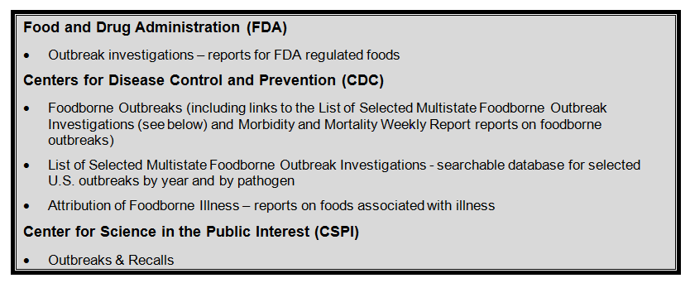
PCHF Guidance – Chapter 2
Sources of Data about Outbreaks
Notes:
A facility’s Food Safety Team should consider foodborne illness outbreaks in the same or similar products, as well as data on foodborne illness outbreaks provided from other product types that may be relevant, or from foods prepared in retail food establishments rather than in manufacturing facilities. Several publicly available resources can provide such information. For example, we provide information on our findings related to outbreaks, including a discussion, whenever possible, of factors that would have contributed to the outbreak at the processing or production site for the foods we regulate.

Slide 17
PCHF Guidance – Chapter 3 Purpose of Chapter
Potential Hazards Associated with the Manufacturing, Processing, Packing, and Holding of Human Food
Help facilities that manufacture, process, pack, or hold human food to evaluate biological, chemical, and physical hazards that are commonly of concern in food plants and that should be addressed in a hazard analysis.
It addresses:
ingredient-related hazards,
process-related hazards, and
hazards that may be introduced from the food-production environment (facility-related hazards).
Notes:
It is important for a facility to understand the potential hazards that may be associated with its products using the raw materials and other ingredients, processes, and equipment specific for those products, as well as the environment of the specific facility.
If a facility identifies hazards requiring a preventive control, it will then have to determine what preventive controls are needed to reduce food safety risks and ensure the safety of your products for human consumption. See 21 CFR 117.130 and 117.135.
Although this chapter briefly describes the types of preventive controls that may be appropriate for a facility to implement to control certain hazards, see Chapter 4 and forthcoming Chapters 6 through 13 of this guidance for more detailed discussion of applicable preventive controls. In addition, Chapter 14 describes the Recall Plan, which is required when a food is associated with a hazard requiring a preventive control.

Slide 18
PCHF Guidance – Chapter 3
Highlights Potential Hazards Associated with the Manufacturing, Processing, Packing, and Holding of Human Food
It does not provide an exhaustive compendium of hazards or details about each hazard.
Notes:
Chapter 3 provides guidance on hazards that are commonly of concern in food plants and that should be addressed in a hazard analysis.
It addresses ingredient-related hazards, process-related hazards, and hazards that may be introduced from the food-production environment (facility-related hazards).
It does not provide an exhaustive compendium of hazards or details about each hazard.
Where possible, scientific literature, regulations, and/or guidance (issued by FDA or our food safety regulatory partners) is referenced that may provide useful detailed discussion or analysis of hazards of concern.

Slide 19
PCHF Guidance – Chapter 3
Key Content:
Where possible, scientific literature, regulations, and/or guidance (issued by FDA or our food safety regulatory partners) is referenced
Hazards Tables found in Appendix 1
Food Categories
Food Subcategories
Potential biological, chemical and physical hazards that are food related and process-related
Appendix 1
Potential Hazards for Foods and Processes
Tables
Notes:
There are two key content points to be made for Chapter 3.
While the text in Chapter 3 characterizes the various potential hazards to be considered in a hazard analysis, the content of the Hazards Tables found in Appendix 1 provides a more detailed assessment of the potential hazards to be considered for various Food Groups as we will see in upcoming slides.

Slide 20
PCHF Guidance – Chapter 3
Key Content:
Scientific Literature and Data
Information provided for background and basis for hazard identification.
Notes:
The scientific literature cited in the PCHF Guidance Chapter 3 is intended to provide those conducting a hazard analysis the scientific basis and background on classifying and identifying potential hazards that are ingredient and food-related, process-related, and from the facility environment.
This chapter provides an overview of the potential ingredient and food commodity related hazards by category (e.g., biological, chemical, and physical). The information basically frames the primary hazards that will be encountered and analyzed in food manufacturing.
The technical content and other tables found in the PCHF Guidance, provide context to these various hazards, much like a published scientific review.

Slide 21
PCHF Guidance – Chapter 3
Hazards Tables Content
Provides data based on scientific literature, FDA / CDC / USDA data, industry data and experience, etc.
The tables found in Appendix 1 are intended for use in considering potential hazards
Hazards Tables Review
Understand the structure of the hazards tables
Understanding how to access the information contained in the tables
Notes:
(Basically, refer to the content of the slide.)
The Hazards Tables, found in Appendix 1 of this Guide is where the data intended for use in considering potential hazards while conducting a hazard analysis is found. Again, this data while based on credible and numerous databases (both published and agency), scientific reviews, surveillance data, etc., should not be considered the final definitive source for this information. There will always be exceptions. More current and relevant data should always be sought and considered as well.

Slide 22
PCHF Guidance – Chapter 3 Appendix 1
Bakery
Beverage
Chocolate and Candy
Dairy
Dressings and Condiments
Egg
Food Additives
Fruits and Vegetables
Game Meat
Grains
Multi-Component Foods (such as a refrigerated entrée or a sandwich)
Nuts
Oil
Snack Foods
Soups
Spice
Sweeteners
Notes:
This appendix contains information on the potential biological, chemical, and physical hazards that are food-related and process related. The potential hazard information presented covers the following 17 food (including ingredients and raw materials) categories are contained in 17 separate tables.
To help you to identify food-related and process-related hazards for the food categories listed above, this appendix contains three series of tables:
Tables 1-A through 1-Q contain information that you should consider for potential food-related biological hazards.
Tables 2-A through 2-Q contain information that you should consider for potential food-related chemical hazards.
Tables 3-A through 3-Q contain information that you should consider for potential process-related biological, chemical and physical hazards.

Slide 23
PCHF Guidance – Chapter 3 Appendix 1 – cont.
Information provided in each the table is organized to describe:
Food Categories
Food Subcategories
Hazards
Example Products
Appendix 1
Potential Hazards for Foods and Processes
Tables
Notes:
Potential hazards that you should consider for each food subcategory are indicated by an “X” in the column for the hazard being assessed.

Slide 24
PCHF Guidance – Chapter 3 Appendix 1
To help you identify food-related and process-related hazards for the food categories listed, the Appendix contains three series of tables
Tables 1A-1Q – info for potential food-related biological hazards
Tables 2A-2Q – info for potential food-related chemical hazards
Tables 3A-3Q – info for potential process-related biological, chemical, and physical hazards
Notes:
This appendix contains information on the potential biological, chemical, and physical hazards that are food-related and process related. The potential hazard information presented covers the following 17 food (including ingredients and raw materials) categories are contained in 17 separate tables.
To help you to identify food-related and process-related hazards for the food categories listed above, this appendix contains three series of tables:
Tables 1-A through 1-Q contain information that you should consider for potential food-related biological hazards.
Tables 2-A through 2-Q contain information that you should consider for potential food-related chemical hazards.
Tables 3-A through 3-Q contain information that you should consider for potential process-related biological, chemical and physical hazards.

Slide 25
PCHF Guidance – Appendix 1 Biological Hazards Table Used to Determine Potential Hazards in Pasteurized Milk an Ingredient used in Making Ice Cream with Inclusions
Table 1E: Information that you should consider for potential ingredient or other food-related biological hazards for Dairy Items
Notes:
The table on this slide is the first, of 17 tables comprised of Tables 1-A through 1-Q that contain information that you should consider for potential food-related biological hazards. These tables are found in Appendix 1 of the Guide.
First, the Food Group for which the information is provided will always be listed in the table title. In this case Bakery Items.
Second, the table is constructed going from left to right with columns indicating Category – the main subdivision of the individual 17 food groups;
# - which provides for repetitive separation of Subcategories within the Category to accommodate 508 compliance;
Subcategory – this provides further descriptive details on how to separate raw material, ingredient, and food items within the Category and these as shown will be associated with the # designation for example within Bakery Items/Unbaked RTB/Breads, biscuits, etc., they will be designated the #1a Subcategory. This allows for the separation by Storage Conditions which is the next column such as Refrigerated – 1a from Frozen – 1b. Depending upon the Food Group, not all tables will indicate Storage Conditions.
After Storage Conditions, we then list the various potential Biological Hazards to be considered. (Read across the table for the hazards).
The hazards to be considered are indicated by the “X” in the column for a particular hazards. (Demonstrate on slide)
The final column lists Example Products for the Subcategory and is not intended to be exhaustive.
This construct is exactly the same for each of the 51 Hazards Tables. If you were to go to the Bakery Items Table for Chemical Hazards, Table 2A of Appendix 1 in the Guide. (Next slide)

Slide 26
PCHF Guidance – Appendix 1 Biological Hazards Table Used to Determine Potential Hazards in Tree Nuts an Ingredient used in Making Ice Cream with Inclusions
Table 1L: Information that you should consider for potential ingredient or other food-related biological hazards for Nuts & Seeds
Notes:
The table on this slide is the first, of 17 tables comprised of Tables 1-A through 1-Q that contain information that you should consider for potential food-related biological hazards. These tables are found in Appendix 1 of the Guide.
First, the Food Group for which the information is provided will always be listed in the table title. In this case Bakery Items.
Second, the table is constructed going from left to right with columns indicating Category – the main subdivision of the individual 17 food groups;
# - which provides for repetitive separation of Subcategories within the Category to accommodate 508 compliance;
Subcategory – this provides further descriptive details on how to separate raw material, ingredient, and food items within the Category and these as shown will be associated with the # designation for example within Bakery Items/Unbaked RTB/Breads, biscuits, etc., they will be designated the #1a Subcategory. This allows for the separation by Storage Conditions which is the next column such as Refrigerated – 1a from Frozen – 1b. Depending upon the Food Group, not all tables will indicate Storage Conditions.
After Storage Conditions, we then list the various potential Biological Hazards to be considered. (Read across the table for the hazards).
The hazards to be considered are indicated by the “X” in the column for a particular hazards. (Demonstrate on slide)
The final column lists Example Products for the Subcategory and is not intended to be exhaustive.
This construct is exactly the same for each of the 51 Hazards Tables. If you were to go to the Bakery Items Table for Chemical Hazards, Table 2A of Appendix 1 in the Guide. (Next slide)

Slide 27
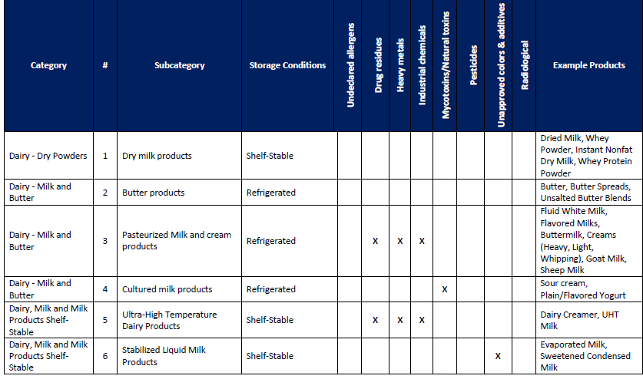
PCHF Guidance – Appendix 1 Chemical Hazards Table Used to Determine Potential Hazards in Pasteurized Milk an Ingredient used in Making Ice Cream with Inclusions
Table 2E: Information that you should consider for potential ingredient or other food-related chemical hazards for Dairy Items
Notes:
Tables 2-A through 2-Q contain information that you should consider for potential food-related chemical hazards.
You will see the exact same Hazards Table construct. The only difference will be the hazards to be considered will now reflect Chemical Hazards. (Read across table)
While individual raw materials or ingredients may not be indicated, the hazards to be considered in this case will have been designated due to hazards associated with the common ingredients for the products listed.
For Bakery Items, one could drill down further say for the flour component by moving to Table 2J for Grains, Beans, and Grain Products.
Looking at Food Category – Milled Grain Products / Subcategory 6 Flour, you could determine the chemical hazards to be considered for the wheat flour component of the bakery item.
Then similarly, to review process related hazards for Bakery Items, you would go to Table 3A, of Appendix 1 in the Guide to determine what process-related hazards should be considered. (Next slide)

Slide 28
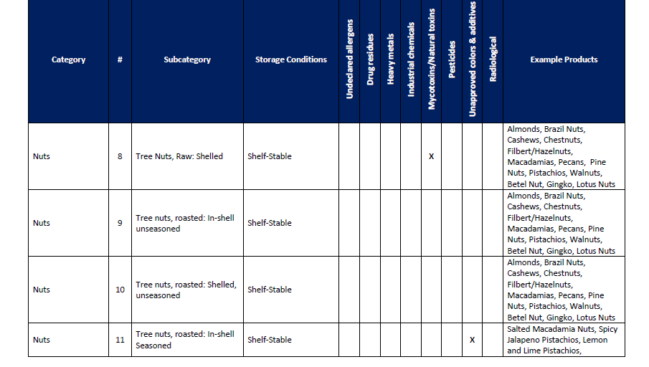
PCHF Guidance – Appendix 1 Chemical Hazards Table Used to Determine Potential Hazards in Tree Nuts an Ingredient used in Making Ice Cream with Inclusions
Table 2L: Information that you should consider for potential ingredient or other food-related chemical hazards for Diary Items
Notes:
Tables 2-A through 2-Q contain information that you should consider for potential food-related chemical hazards.
You will see the exact same Hazards Table construct. The only difference will be the hazards to be considered will now reflect Chemical Hazards. (Read across table)
While individual raw materials or ingredients may not be indicated, the hazards to be considered in this case will have been designated due to hazards associated with the common ingredients for the products listed.
For Bakery Items, one could drill down further say for the flour component by moving to Table 2J for Grains, Beans, and Grain Products.
Looking at Food Category – Milled Grain Products / Subcategory 6 Flour, you could determine the chemical hazards to be considered for the wheat flour component of the bakery item.
Then similarly, to review process related hazards for Bakery Items, you would go to Table 3A, of Appendix 1 in the Guide to determine what process-related hazards should be considered. (Next slide)

Slide 29
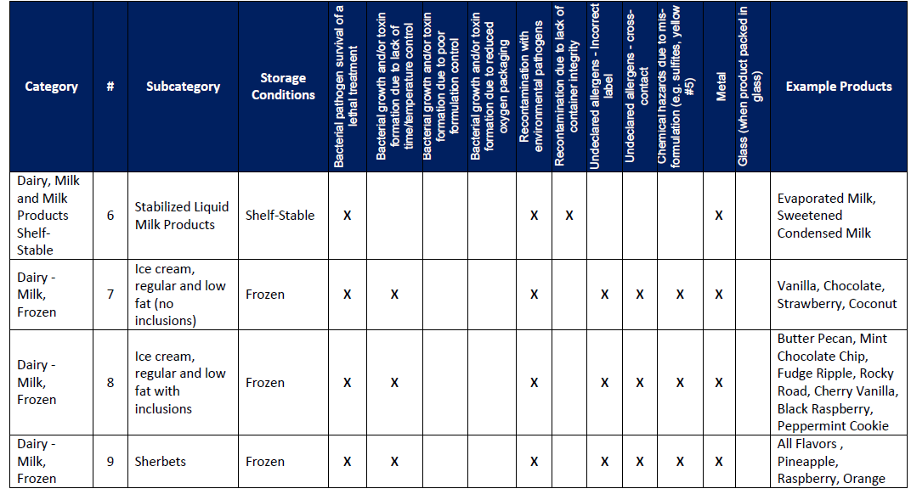
PCHF Guidance – Appendix 1 Process Related Hazards Tables – Ice Cream Example
Table 3E: Information that you should consider for potential process-related biological, chemical, and physical hazards for Dairy Items
Notes:
Tables 3-A through 3-Q contain information that you should consider for potential process-related biological, chemical and physical hazards.
Again, the basic construct of the table is identical to the biological and chemical hazards tables. The only difference is the hazards that are indicated for consideration. This process-related hazards as shown is a bit more complicated as the biological, chemical, and physical hazards are now considered as related to the food process for the indicated Food Group / Food Category / Food Subcategory.
(Review the hazards indicated on the table)
The biological hazards are represented by the first six hazards (read them from the table).
The chemical hazards are represented by the next three hazards (read them from the table).
And the physical hazards are represented by the last two hazards (read them from the table).

Slide 30
PCHF Guidance – Chapter 4 Purpose of Chapter
Preventive Controls
The guidance provided in this chapter is intended to help facilities that manufacture, process, pack, or hold human food to identify and implement preventive controls.
Notes:
The guidance provided in this chapter is intended to help facilities that manufacture, process, pack, or hold human food to identify and implement preventive controls.
The Preventive Controls rule requires a facility to identify and implement preventive controls to provide assurances that any hazards requiring a preventive control will be significantly minimized or prevented and the food manufactured, processed, packed, or held by the facility will not be adulterated under section 402 of the Federal Food, Drug, and Cosmetic Act (FD&C Act) (21 U.S.C 342) or misbranded under section 403(w) of the FD&C Act (21 U.S.C. 343(w)). (See 21 CFR 117.135(a)(1)).

Slide 31
PCHF Guidance – Chapter 4
Chapter 4 provides general information on preventive control programs that a facility could use to control a hazard. They include:
Preventive Control | Chapter Section
Process Controls | 4.3
Sanitation Controls | 4.4
Food Allergen Controls | 4.5
Supply-chain Controls | 4.6
Recall Plans | 4.7
Notes:
This table lists the sections in this chapter in which we address process controls, sanitation controls, food allergen controls, supply-chain controls, and recall plans.
Although supply-chain controls are included here, more information will be forthcoming via draft guidance “Supply-Chain Program for Human Food Products: Guidance for Industry.”
Also, see forthcoming Chapters 6 through 14 of this guidance for more detailed discussion of applicable preventive controls.

Slide 32
PCHF Guidance – Chapter 4 Process Controls
Process controls include procedures, practices, and processes to ensure the control of parameters during operations such as heat processing, acidifying, irradiating, and refrigerating foods.
Process controls do not include those procedures, practices, and processes that are not applied to the food itself, e.g., controls of personnel or the environment that may be used to significantly minimize or prevent hazards.
Notes:
Key to remember that process controls must be those procedures, practices, or processes that are applied to the food directly.
They will include parameters associated with the control of the hazard, and will be characterized as a maximum or minimum value or combination of values to which control must be maintained.

Slide 33
PCHF Guidance – Chapter 4 Process Controls
Process Control Subcategory | Hazard Category | Examples | Chapter Section
Lethal Treatments | Biological | Heat treatments (also called thermal treatments) (e.g., cooking, roasting, baking) High Pressure Processing (HPP) Irradiation Antimicrobial fumigation (e.g., with propylene oxide (PPO)) | 4.3.1
Time/Temperature of Holding | Biological | Refrigeration Freezing | 4.3.2
Formulation | Biological | Reducing the water activity Reducing the pH (acidification) Adding preservatives | 4.3.3
Dehydration/Drying | Biological | Air-drying (forced air and heating) Freeze drying Spray drying | 4.3.4
Recipe Management | Chemical | Controlling the maximum level of food ingredients | 4.3.5
Storage Conditions | Chemical | Controlling moisture during storage of raw agricultural commodities | 4.3.6
Physical Sorting | Chemical | Reducing mycotoxin content through sorting by color and physical damage in raw agricultural commodities | 4.3.7
Exclusion of Metal and Glass | Physical | Using magnets Using metal detectors Using sieves, screens Using X-ray systems | 4.3.8
Notes:
(Highlight table construct referring to table column headers.)
(Pick a biological , a chemical and a physical hazard related process control and highlight table content)

Slide 34
PCHF Guidance – Chapter 4 Sanitation Controls
Sanitation controls must include, as appropriate to the facility and the food, procedures, practices, and processes for the:
Cleanliness of food-contact surfaces, including food-contact surfaces of utensils and equipment; and
Prevention of allergen cross-contact and cross-contamination from insanitary objects and from personnel to food, food packaging material, and other food-contact surfaces and from raw product to processed product.
Notes:
Sanitation controls include procedures, practices, and processes to ensure that the facility is maintained in a sanitary condition adequate to significantly minimize or prevent hazards such as environmental pathogens, biological hazards due to employee handling, and food allergen hazards.
The facility should determine which hazards require a sanitation control, rather than CGMPs, through their hazard analysis. Thus, some – but not all - of the sanitation procedures, practices, and processes will be “sanitation controls”; other sanitation procedures, practices, and processes will be CGMPs.

Slide 35
PCHF Guidance – Chapter 4 Food Allergen Controls
Food allergen controls include procedures, practices, and processes to control food allergens. Food allergen controls must include those procedures, practices, and processes employed for:
Ensuring protection of food from allergen cross-contact, including during storage, handling, and use; and
Labeling the finished food, including ensuring that the finished food is not misbranded under section 403(w) of the FD&C Act (21 U.S.C. 343(w)).
Notes:
Basically, read the slide.
More detailed guidance on Allergen controls will be provided in the forthcoming Chapter 11.

Slide 36
PCHF Guidance – Chapter 4 Supply-Chain Controls
In this section of this guidance, we discuss the use of ingredient specifications as a supply-chain control for several chemical hazards –
pesticides,
drug residues,
heavy metals,
mycotoxins.
See FDA’s draft guidance “Supply-Chain Program for Human Food Products: Guidance for Industry” for in-depth guidance on supply-chain controls.
Notes:
(Basically, read the slide.)
Possible that this guidance may become Chapter 15

Slide 37
PCHF Guidance – Chapter 5 Purpose of Chapter
Application of Preventive Controls and Preventive Control Management Components
This chapter provides an overview of the application of preventive controls to significantly minimize or prevent the occurrence of biological, chemical, and physical hazards in finished foods and the food production environment.
This chapter also provides an overview of preventive control management components (i.e., monitoring, corrective actions, and corrections, and verification activities (and their associated records)).
Notes:
(Highlight slide content)

Slide 38
PCHF Guidance – Chapter 5 Biological Hazards
Provides general information about the effects of the listed preventive controls but is not intended to imply that a particular preventive control has been validated for control of specific pathogens in specific foods.
You are responsible for validating specific preventive controls as appropriate to the nature of the preventive control and its role in your facility’s food safety system
Notes:
(Highlight slide content)

Slide 39
PCHF Guidance – Chapter 5
Examples of the Application of Preventive Controls for Chemical Hazards
Examples of the Application of Preventive Controls for Food Allergen Hazards
Examples of Application of Preventive Controls for Physical Hazards
Notes:
(Highlight slide content)

Slide 40
PCHF Guidance – Chapter 5
Overview of Preventive Control Management Components
Monitoring;
Corrective actions;
Corrections, and;
Verification activities (and their associated records).

Slide 41
PCHF Guidance – Chapter 6 Purpose of Chapter
Use of Heat Treatments as a Process Control
This chapter explains how to establish and implement a heat treatment (e.g. baking or cooking) as a process control for bacterial pathogens.
Notes:
(Highlight slide content)

Slide 42
PCHF Guidance – Chapter 15 Purpose of Chapter
Supply-Chain Program for Human Food Products
The purpose of this chapter is to help a receiving facility comply with the requirements of subpart G for establishing and implementing a supply-chain program for its suppliers.
This chapter also is intended to help an entity other than the receiving facility conduct certain activities on behalf of a receiving facility, provided that the receiving facility complies with applicable requirements in subpart G to review and assess the entity’s applicable documentation, and document that review and assessment.
Notes:
(Highlight slide content)

Slide 43
PCHF Guidance Summary
Review:
Structure of the guidance document
Key content
How to use Appendix 1
Guidance still to come
Notes:
In Summary:
The purpose of this draft guidance is to help companies create a food safety plan to prevent food contamination and meet the requirements of the Preventive Controls for Human Food final rule.
Structure:
The first five chapters cover a variety of topics, including:
How to conduct a hazard analysis
Potential Hazards to be Considered
How to apply preventive controls, should they be needed
Monitoring, corrective action and verification
And the recordkeeping requirements associated with your food safety plan
Key Content:
We’ve included an extensive glossary in the guidance to define terms found throughout the guidance document as well as terms in the Preventive Controls rule.
We’ve also provided considerations for firms that already have a HACCP plan.
An overview of the biological, chemical and physical hazards that could be introduced into a food product
The remaining nine chapters, which will be released in sets through early 2018, will touch on the following subjects:
Different process controls, such as heat, formulation, drying or dehydration, and sanitation
Food allergen controls
Preventive controls for chemical and physical hazards
And recall plans.

Slide 44
Additional Hazard Analysis Resources
Simplified look-up table to the FDA Potential Hazard Guide:
http://www.foodcontrolmethods.com/guidance/lookup

